Slide 1
Early Learning Advisory Council Meeting
December 10, 2020

Slide 2
Welcome and Introductions
Barbara Tedrow, ELAC Chair

Slide 3
Establish Quorum
Barbara Tedrow, ELAC Chair

Slide 4
Approval of Minutes
Barbara Tedrow, ELAC Chair

Slide 5
School Reopening
Sub-Committee Update
Barbara Tedrow, ELAC Chair

Slide 6
Moments Together Campaign Update
Sommer Smith, Media Desk

Slide 7
Early Childhood Education and Care Department Updates
Elizabeth Groginsky, Secretary
Jovanna Archuleta, Assistant Secretary for Native American Early Education and Care
Alejandra Rebolledo Rea, Division Director
Mayra Acevedo, Division Director

Slide 8
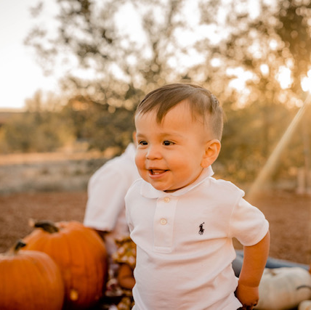
Agenda
Early Childhood Landscape
Agency Overview
FY22 Budget Request
2020 Government-to-Government
Responding to Families Needs During the Public Health Emergency

Slide 9

EARLY CHILDHOOD LANDSCAPE IN NEW MEXICO

Slide 10
Early Childhood Professionals
Program Type | Estimated Numbers
Child Care | 8,958
NM PreK (public and private) | 1,362
Home Visitors | 270
Head Start and Early Head Start | 2,210
Early Intervention Professionals | 808
Consultants and Coaches | 105
Total Early Childhood Professionals | 13,662
This data is captured from internal and external data sources
Notes:
Workforce growth: aiming to grow by 10% per year.
HV workforce: for 1000 new families, need 50 new professionals. (20 cases per professional)
Perhaps provide a few other examples.
Home visitors: 270 is the FY20 number.
Private: 641
Public: 721
15,288
(speech language, PT, OT, development therapists, service coordinators)

Slide 11
Families and Children
Total Families in New Mexico | 162,623
Families Living at or Below 200 Percent of Federal Poverty Level (FPL) | 53,665 (33%)
Children Birth to Age 5 | Number | Percent Living at or Below 100 Percent of Federal Poverty Level (FPL)
Hispanic | 72,793 | 31.3
Native American | 13,048 | 40.3
Black/African-American | 1,063 | 37.1
Asian | 1,310 | Not Available
Caucasian | 28,640 | 17.2
Two or More Races | 9,211 | 32.3
Other: | 6,575 | 27.4
TOTAL: 116,978 | 116,978 | 28.9
Sources: US Census ACS, 1 year data from 2017-2019, Tables B01001 (B-I) and B17001 (B
Sources: US Census ACS, 1 year data from 2019, Table S1702; and PRB analysis of ACS data

Slide 12
Annual Births
Race and Ethnicity | Number | Percent
Hispanic: | 12,914 | 56.2
Native American | 2,766 | 12
Black/African-American | 477 | 2
Asian | 525 | 2.3
Caucasian | 6,232 | 27.1
Other | 52 | 0.2
TOTAL | 22,966
Medicaid-Funded Births per Year: | 72%*
Source: NM-IBIS - Query Result - New Mexico Birth Data - Count (state.nm.us)
*2015 Data

Slide 13
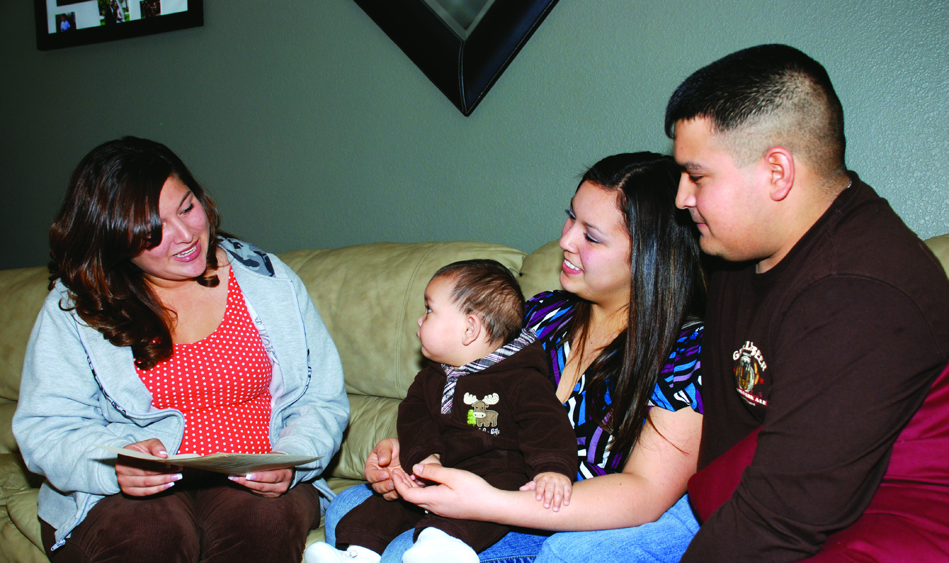
AGENCY OVERVIEW

Slide 14
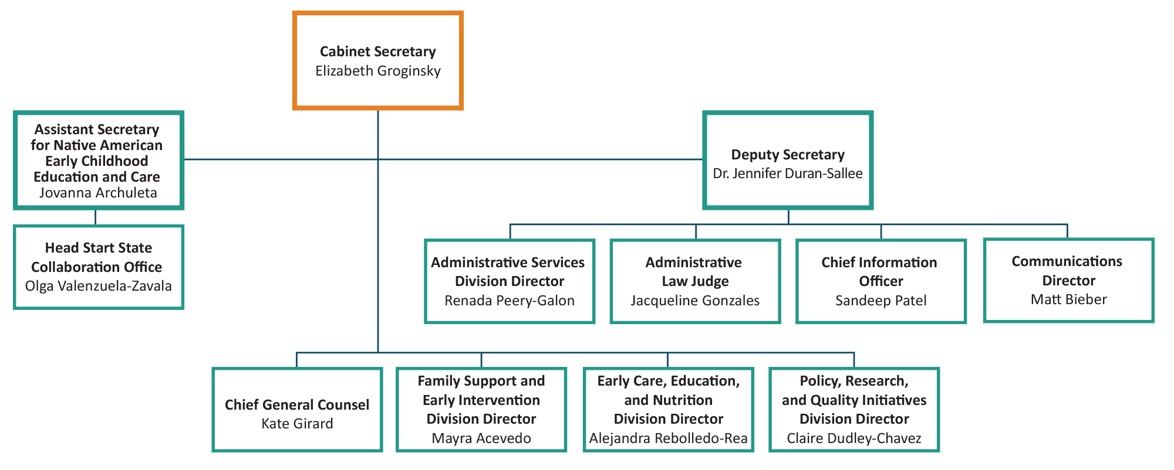
Organizational Chart – Top Level

Slide 15
Strategic Priorities
Grow
Grow Investments
Advance
Advance a Diverse, Well-Compensated, and Credentialed Workforce
Increase
Achieve Equity
Enhance
Enhance Authentic Collaboration with Families and Communities
Increase Quality and Access
Achieve

Slide 16
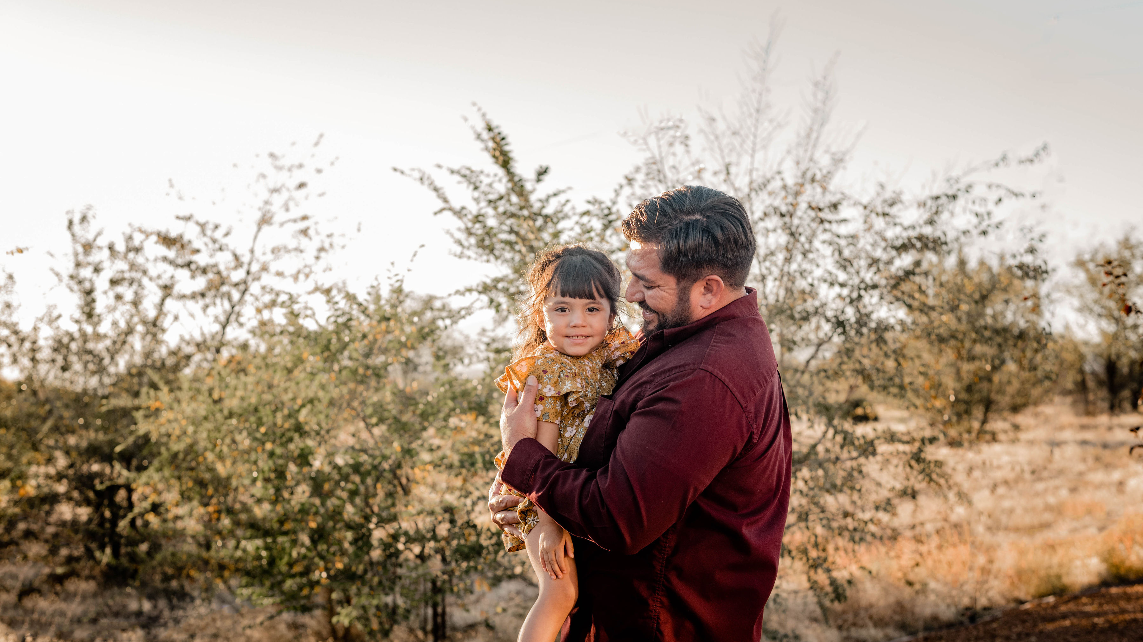
FY22 AGENCY BUDGET REQUEST

Slide 17
Community-Based Home Visiting
 | FY 2020 | FY 2021 | FY 2022
Budget | $22,771,070 | $25,482,500 | $26,005,437
Families Served | 6,154 | 6,709 (projected) | 7,280 (projected)
Highlights
Established a public-private working group to plan expansion of Centennial Home Visiting (plan will be completed in April)
Offer evidence-based models in nine of the state's home visiting organizations

Slide 18
Family, Infant and Toddler (FIT) Program
 | FY 2020 | FY 2021 | FY 2022
Budget | $27,853,281 | $33,231,500 | $34,050,100
Children Served | 14,994 | 15,542 (projected) | 16,319 (projected)
Highlights
All FIT families can access tele-health and limited in-person services
In the first quarter of FY21, 53 percent of the 1,549 children referred were under age one
Notes:
Limited

Slide 19
Families FIRST
 | FY 2020 | FY 2021 | FY 2022
Budget | $2,100,000 | $1,799,500 | $3,284,275
Families Served | 1,727 | 1,627 (projected) | 2,127 (projected)
Highlights
Support for COVID-19, Families FIRST nurses have provided nearly 900 hours of testing support across public health offices since July 1
Initiated the process for nurses to provide the Nurse Family Partnership home visiting model
Engaging families through telephone, limited in-person and written communications and support

Slide 20
Child Care Services
 | FY 2020 | FY 2021 | FY 2022
Budget | $148,519,700 | $180,552,800 | $180,552,800
Children Served | 22,173 (actual) | 26,649 (projected) | 26,649 (projected)
Highlights
Issued emergency regulations: expanded eligibility and reduced provider, client, and administrative burden
Maintained services to support vulnerable families, children and essential workers during health emergency
Developed comprehensive COVID-19 Safe Practices, protocols and supports
Waived parent copayments and distributed differential payments to providers to alleviate some financial constraints

Slide 21
New Mexico PreK
Public Schools PreK | FY 2020 | FY 2021 | FY 2022
Budget | $46,299,000 | $48,856,500 | $47,021,800
Children Served | 7,072 | 7,247 | 7,247
Community-Based PreK | FY 2020 | FY 2021 | FY 2022
Budget | $45,994,800 | $51,304,965 | $53,282,675
Children Served | 5,411 | 6,171 | 6,486
Highlights
Launched Joint Application for community-based and public schools PreK services
Enhanced collaboration with the Head Start community
Implemented UPSTART in NM PreK, tribal and Head Start programs

Slide 22
Workforce Development
 | FY 2020 | FY 2021 | FY 2022
Budget | $4,028,900 | $6,502,900 | $9,502,900
Wage Supplement | 230 Participants | 750 Participants | 1,000 Participants
Scholarships | 1,191 scholars | 1,911 scholars | 2,000 scholars
Highlights
Expanded scholarships to all early childhood professionals
Provided wage incentives to more than 3,000 child care professionals through federal CARES Act funding
Launched Quorum, an online professional development platform 24/7 with 120 hours of Spanish courses; 1,587 professionals participating
Funded 30 professionals to participate in CLASS Train-the-Trainer

Slide 23
Early Childhood Trust Fund
In 2020, Senate Bill 83 created the Early Childhood Trust Fund (ECTF)
On July 1, 2021, a distribution will be made from ECTF to the Early Childhood Education and Care Program Fund in the amount of $20 million
The Early Childhood Education and Care Program Fund is a nonreverting fund in the state treasury. The fund consists of distributions, appropriations, gifts, grants, donations, and income from the investment of the fund
The Legislature appropriates the funding, and the Early Childhood Education and Care Department administers the funding

Slide 24
The FY22 Appropriation Request from the Early Childhood Education and Care Program Fund:
  $10 million: maintain investment in NM PreK (private and public)
  $3 million: advance pay parity for NM PreK teachers
  $2 million: expand NM PreK and Early PreK in the private sector
  $2 million: integrate data systems by acquiring physical hardware and software, routers, switches and backup devices and invest in IT infrastructure
  $2 million: expand home visiting
  $1 million: increase Families FIRST care and support

Slide 25
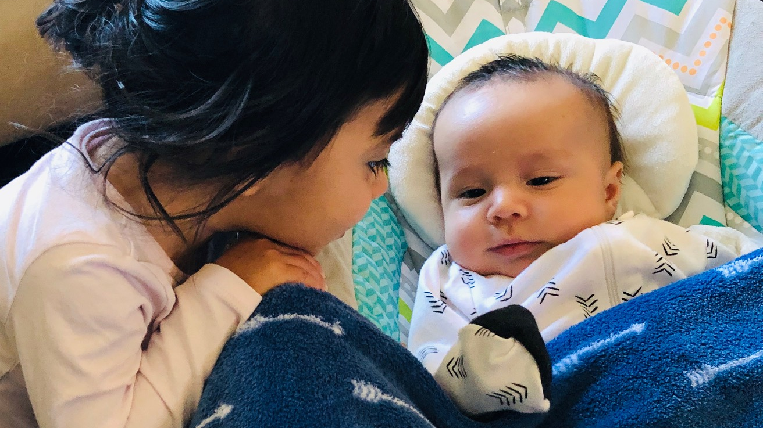
PRESCHOOL DEVELOPMENT GRANT BIRTH TO FIVE (PDG B-5) STRATEGIC PLAN

Slide 26


Slide 27
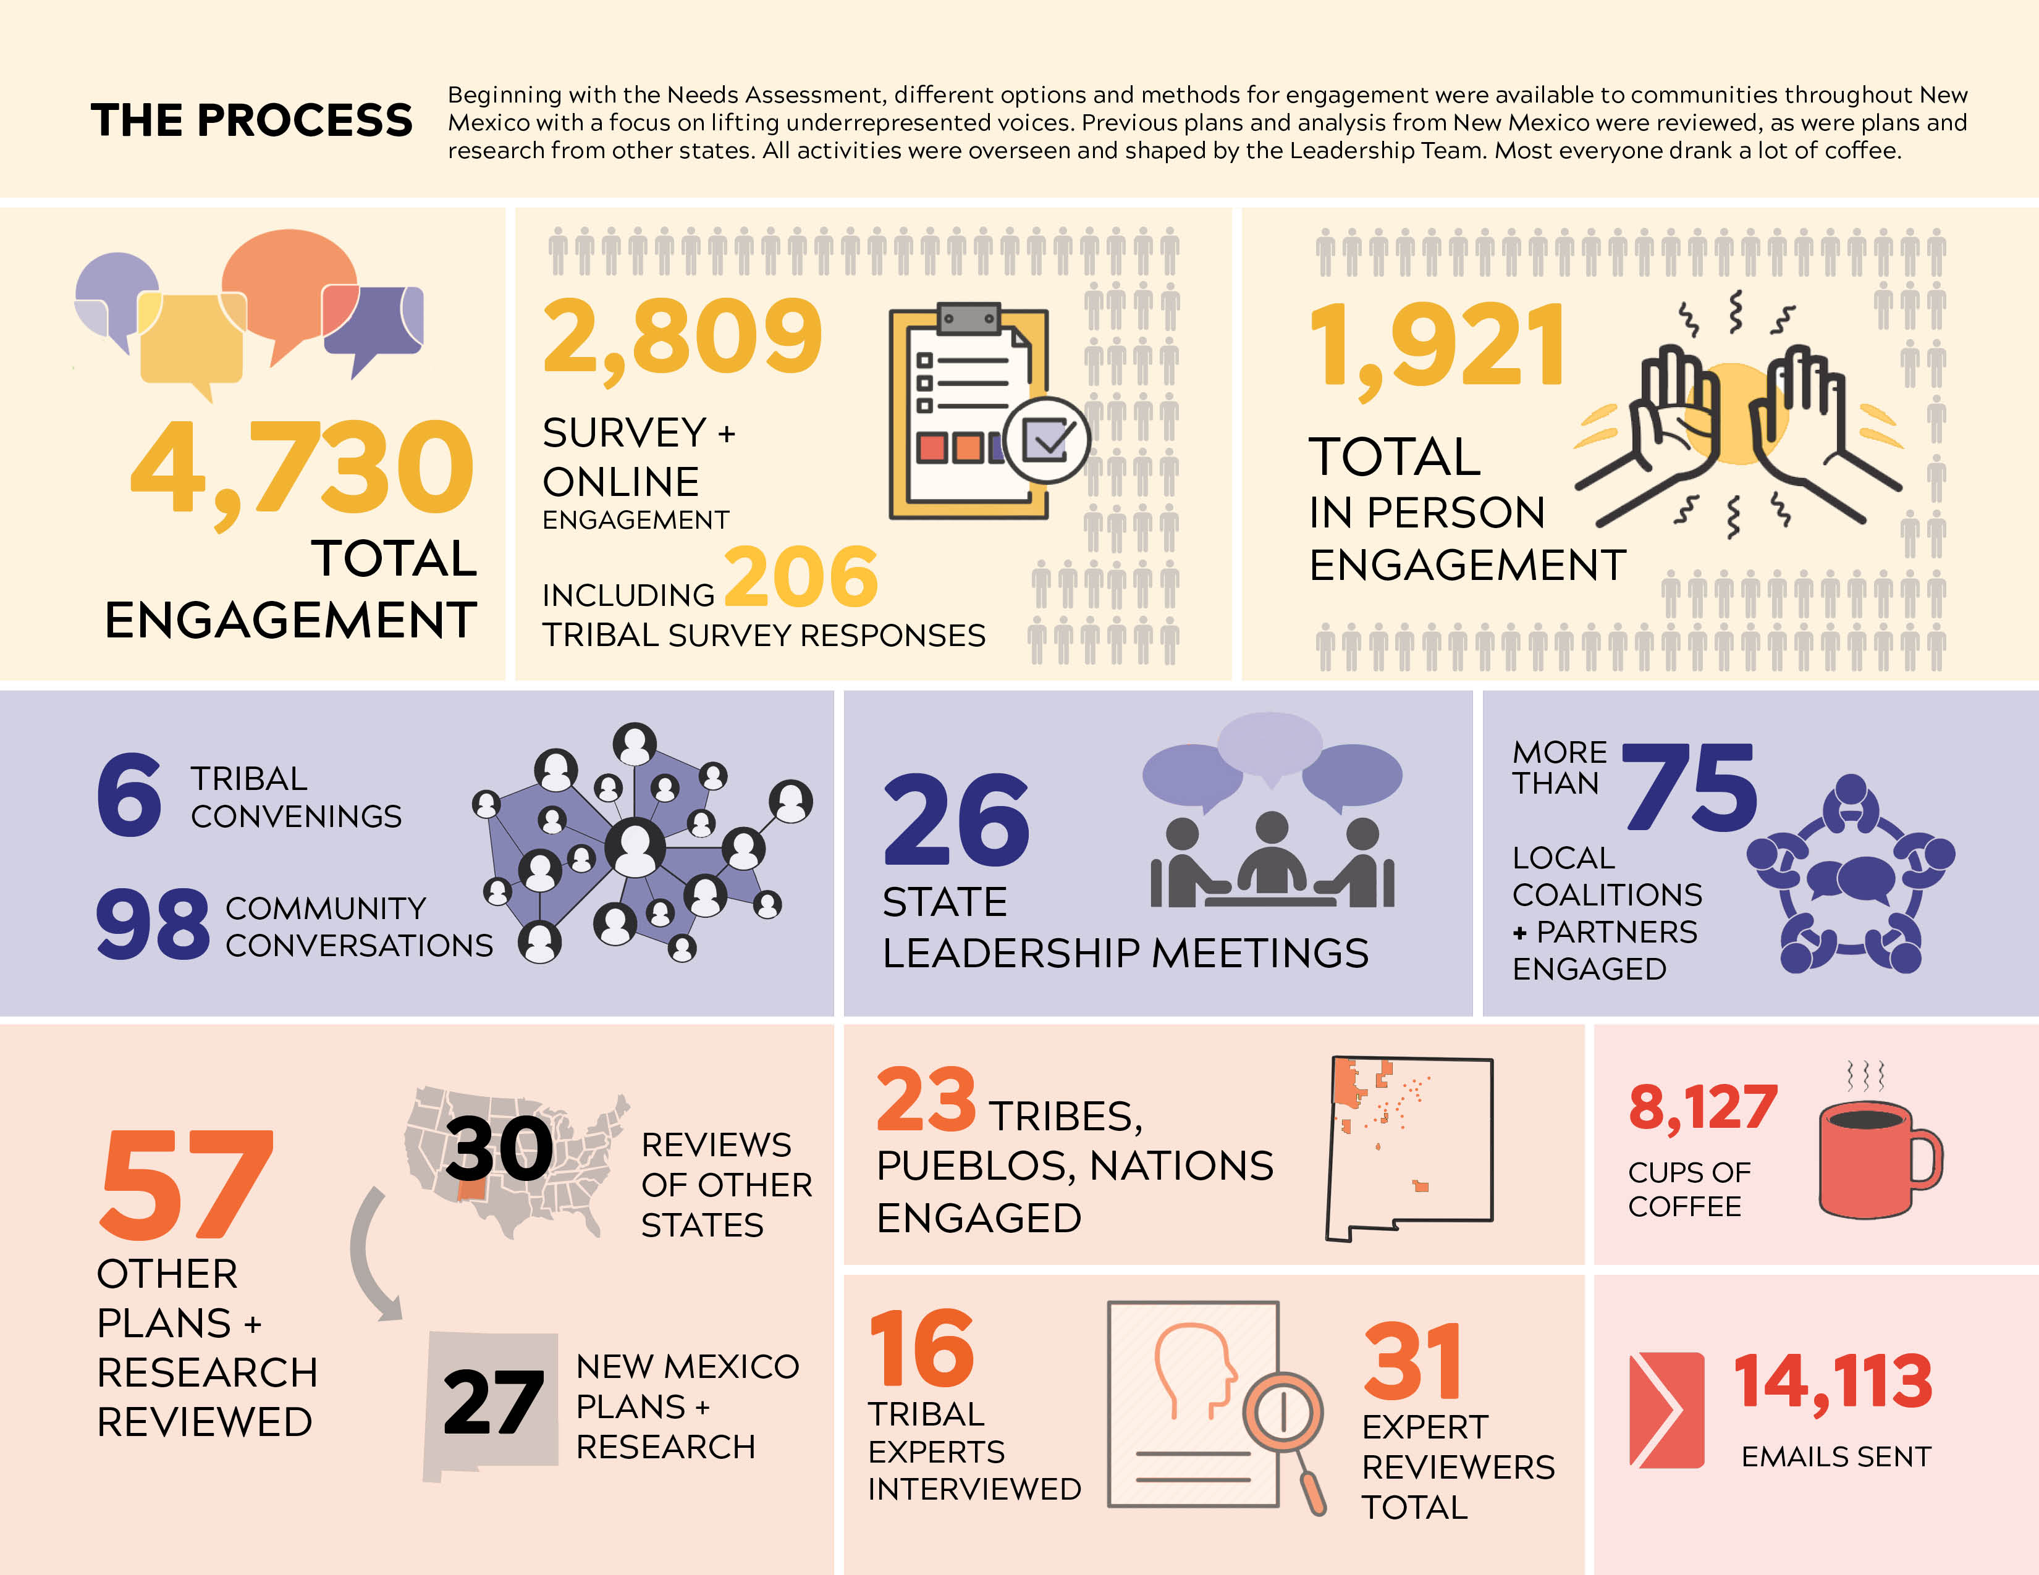

Slide 28
Strategic Plan Guiding Principles
EQUITABLE ACCESS
  Ensure respect for and celebration of New Mexico’s multicultural and multilingual diversity
  Seek to heal trauma, including historical and generational trauma, and deconstruct systemic racism and social injustice
  Prioritize resources and opportunities for those with greatest need
COORDINATION AND COLLABORATION
  Foster transparency through clear and consistent communications and build trust in all areas and relationships with early childhood programs and tribal partners
  Build on and magnify local assets and abilities to solve local problems; including social capital, networks, and relationships
QUALITY
  Embrace continuous improvement
  Use developmentally appropriate approaches and inclusive practices for working with all children and families
  Support early childhood educators and cultural knowledge systems
  Ensure best practices and healthy environment and interactions throughout the system

Slide 29
Goal One: Recognize all families in New Mexico as key decision makers and ensure they have access to the resources they need to thrive
  Objective 1A. Ensure that 70 percent of early childhood programs and services are designed to support multi-lingual, multi-generational and culturally diverse households by Dec. 2024
  Objective 1B. Provide full program access to recipients by addressing languages, availability, and other barriers to accessing needed programs and services
  Objective 1C. Increase parent and caregiver awareness of early childhood services by 15 percent annually

Slide 30
Goal Two: Create a cohesive governance system that supports an aligned, efficient and responsive system of high-quality early childhood programs and services
  Objective 2A. Develop an aligned, consumer support process that recognizes and celebrates New Mexico's diversity
  Objective 2B. Align state-funded early childhood program requirements across the mixed delivery systems
  Objective 2C. Strengthen partnerships at the state and local levels to effectively use all available resources across the mixed-delivery system by Dec. 2024

Slide 31
Goal Three: Ensure that New Mexico's early childhood workforce is supported to meet the needs of all families and young children through an aligned professional development system and through compensation that reflects the level of experience and training
  Objective 3A. Support and adequately compensate the workforce in order to ensure their physical and social well-being
  Objective 3B. Increase, by 10 percent annually, the number of degreed and credentialed professionals within the early childhood workforce
  Objective 3C. Align professional development training and technical assistance

Slide 32
Goal Four: Provide sustainable and secure funding to support New Mexico's youngest children and their families
  Objective 4A. Maximize and leverage all possible funding
  Objective 4B. Create flexible funding opportunities to incentivize outcomes rather than process measures
  Objective 4C. Identify the true cost of care and increase collaboration and funding available to increase access to quality programs

Slide 33
Goal Five: Develop a statewide, integrated data system to better inform planning and decision-making for all stakeholders
  Objective 5A. Ensure alignment and sharing of data across state-level departments and systems, plus medical practice and insurance data, while maintaining the ethical use of data and total privacy and confidentiality of individuals, including PII and HIPPA-protected
  Objective 5B. Promote accountability, enhance practice, and guide continuous quality improvement
  Objective 5C. Define, design and integrate data into a unified public interface to allow transparency of aggregate information throughout the system

Slide 34
Goal Six: Strengthen ongoing government- to-government relationships with all tribal communities in order to foster mutual trust, understanding, and partnerships that respect tribal sovereignty
  Objective 6A. Ensure 100 percent of children in tribal communities have access to facilities that promote the integration of education, language and culture as identified and defined by tribal communities by 2024
  Objective 6B. Enhance knowledge and respect of the culture, sovereignty and self-determination and governance of tribes and programs
  Objective 6C. Adhere to existing laws relating to tribal nations.

Slide 35

GOVERNMENT-TO-GOVERNMENT

Slide 36

2020 Government-to-Government Tribal Summit
Collaboration with PED and HED
Cradle to Career Approach
Guidance provided by Tribal Leaders

Slide 37
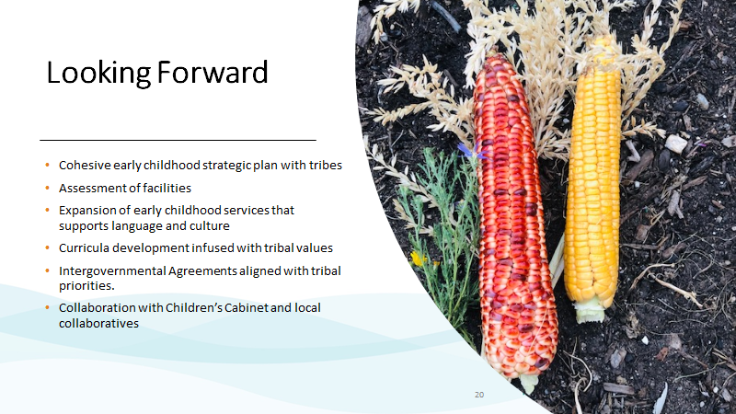

Slide 38
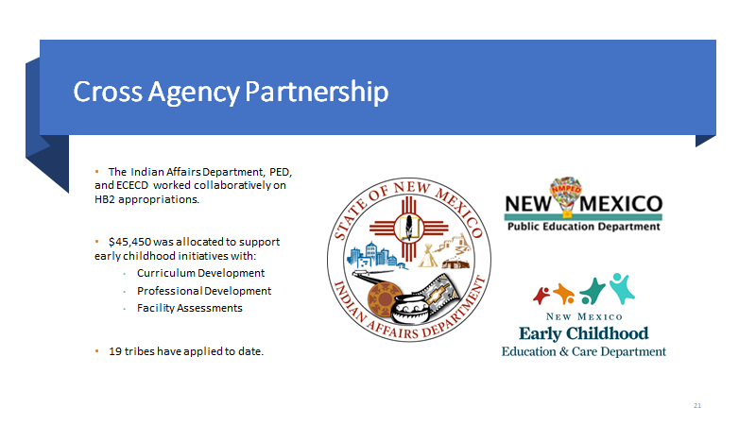

Slide 39

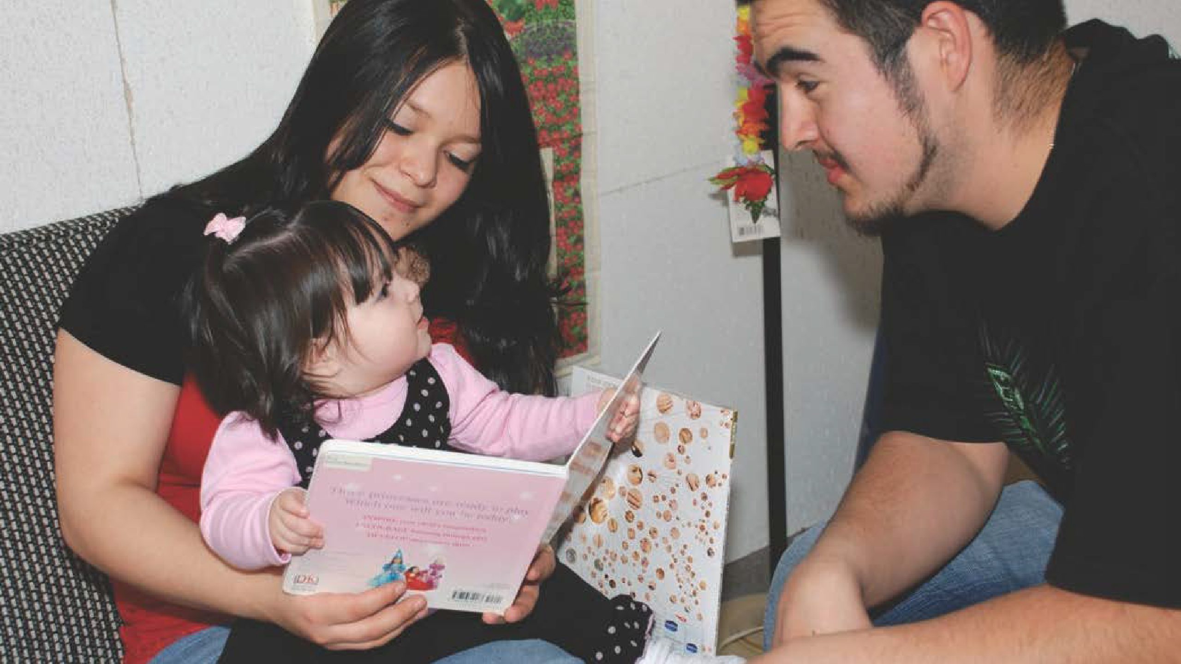

RESPONDING TO THE NEEDS OF FAMILIES DURING THE PUBLIC HEALTH EMERGENCY

Slide 40
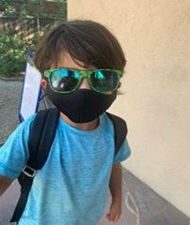
Early Care, Education, and Nutrition
Alejandra Rebolledo Rea, Director
Family Nutrition Services
  Served more than seven million meals across the state since March 2020
  Received several waivers from USDA for Summer Food Program Services, Child and
  Adult Care Food Program and At-Risk Programs
  Established Meals to You Services prioritizing tribal communities
  Collaboration with USDA, PED, IAD, HSD and ALTSD
Child Care Services
  Engagement and participation of the child care sector since the beginning of the pandemic
  Established COVID-Safe practices and protocols
  Established supports for parents and providers – copay waiver, FFN path, essential worker supports, differential payments, wage support and stabilization grants
  Issued emergency regulation changes
PreK Services
  Guidance to programs - flexibility and parental needs
  Communication with families
  Consultation for remote learning support
  JumpStart, Connect for Learning opportunities to support PreK programs
Notes:
Established COVID-Safe Practices and Protocols
Reporting requirements and rapid response mechanisms
Testing requirements – implementation of pilot for onsite testing

Slide 41
Family Support and Early Intervention
Mayra Acevedo, Director
Families FIRST
  Provided 1,727 care and pediatric coordination visits virtually
  Administer COVID-19 testing – 100-150 per day
  Rapid Response Support – Early Childhood Professionals and Families
  Connect families to resources and Medicaid enrollment support
Home Visiting
  Received waiver to allow for virtual visits
  Supported virtual visit engagement
  Experienced an increase in the number of visits, 4867 per month.
  Distributed supplies: baby formula, technology equipment, food and home visiting brochures and learning activity packages
  COVID-19 Safety Guidance Workgroup
FIT
  Introduced tele-health services overnight
  Distribution of personal protective equipment (PPE) to FIT providers
  Served 9,311 children by tele-health since March 2020.
  Provided 199,391 hours of tele-health services from March – July 2020
  Worked with Medicaid to ensure coverage of phone only tele-health services.
  Developed COVID-19 Safety Guidance for in-person services
  Conducted focus groups with providers and parents - Tele-health services and
  COVID-19 Guidance.
Notes:
Parents Reaching Out – over 20 families participated. Felt supported by early intervention providers- coached me through the strategies.
Provider focus groups - Thankful for coaching training

Slide 42
Quorum Presentation
Gillian Gansler, Vice President, Business Development, Quality Assist, Inc.

Slide 43
Early Learning Advisory Council Member
Announcements

Slide 44
Public Comment Period

Slide 45
Next Meeting Date
March 2021
  Preschool Development Grant Update
  Equity Council Update

