Slide 1

Civil Rights
Annual Training - 2019

Slide 2
Topics that will be covered
Collection and use of data
effective public notification systems
complaint procedures
Compliance review techniques
Resolution of noncompliance
Requirements for reasonable accommodation of persons with disabilities
Requirement for language assistance
Conflict resolution
customer service

Slide 3


What is Civil Rights ???
Are the rights of individuals to receive equal treatment (and to be free from unfair treatment or "discrimination") in a number of settings; including education and employment.
CACFP funds are Federal Tax Dollars made available through USDA to Partner State Agencies

Slide 4
Systems for data collection about potentially eligible persons must:
Always have instructions, policies and guidelines for each program regulation.
Be maintained for 3 years
continue to submit to FNB each year

Slide 5

Be sure that any graphics, pictures or clip art that you use shows a variety & diversity of children.

Slide 6
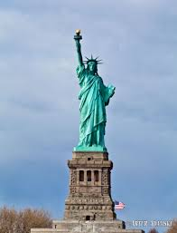
Form #36 should be a part of your renewal application each year.
Form 36 reports the number of participants that are Hispanic or Latino & those who are not.
It also reports on the race of each participant.
Race & ethnicity are 2 different categories.

Slide 7
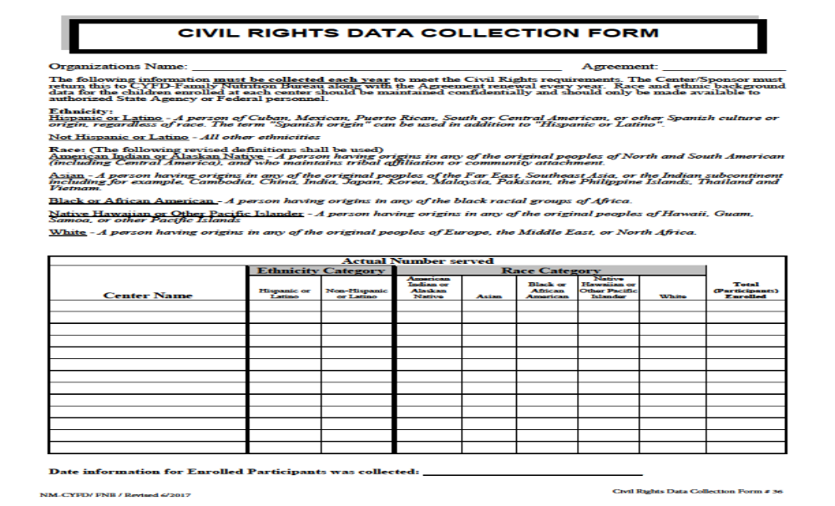
Notes:
Race and ethnic categories are to ensure data quality and will be in separate categories

Slide 8

The information is requested solely for the purpose of determining compliance with federal civil rights laws
Responses will not affect your application and may be protected by the privacy act
Racial & ethnic data is used to determine how effective your program is in reaching eligible participants

Slide 9
Media Notification
Submit the information that is in the box on your media notification letter to the local media.
Generally you want to this right before your application is submitted.
The media means an organization that publicizes things for the general public
Family nutrition will notify the media in subsequent years in a state-wide press release.

Slide 10

Public Notification
Each year organizations must notify the media of their participation in the program. If your organization is new, the media must be notified before you begin operations
NOT Media Coverage
Bulletin Boards
Your center newsletter
Church bulletin
Note sent home with kids
NAEYC newsletter
Texting or a Twitter tweet
Examples of Media
Television
Radio
Newspaper
News Magazines such as New Mexico Kids
Ad booklets such as the Thrifty Nickel
Internet Website

Slide 11

Complaint Procedures
To file a compliant alleging discrimination, complete the USDA program discrimination complaint from, AD-3027 found online @
Http://www.Ascr.Usda.Gov/complaint_filing_cus.Html
Or at any USDA office
Or write to:
Office of the assistant secretary for civil rights
1400 independence ave SW
Washington DC 20250-9410

Slide 12
Complaint procedures
NAME, ADDRESS & PHONE NUMBER OF COMPLAINANT IS NOT REQUIRED
SPECIFIC NAME AND LOCATION OF SPONSOR DELIVERING SERVICE IS REQUIRED
THE NATURE OF THE INCIDENT THAT LED THE COMPLAINANT TO FEEL DISCRIMINATED AGAINST IS NEEDED
THE BASIS ON WHICH THE COMPLAINANT CLAIMS DISCRIMINATION EXISTS IS REQUIRED: WAS DISCRIMINATION BASED ON RACE, COLOR, NATIONAL ORIGIN, SEX, AGE OR DISABILITY?
THE NAMES, TITLES AND BUSINESS ADDRESS OF PERSONS WHO MAY HAVE KNOWLEDGE OF THE DISCRIMINATORY ACTION ARE NEEDED
THE DATES DURING WHICH THE ALLEGED DISCRIMINATORY ACTION OCCURRED ARE NEEDED OR IF SUCH ACTIONS ARE ON-GOING, THAT SHOULD BE SPECIFIED.

Slide 13

Compliance Review Techniques
What do you as a sponsor need to do to show you are in compliance? Check the following items to ensure they have been completed.
Have the “…and justice for all” poster up
Don’t discriminate against any of the protected classes
Notify the media of your participation
Collect race & ethnic data annually
Insure graphics and pictures show diversity
Work to resolve any conflicts
Report any complaints to the state agency

Slide 14
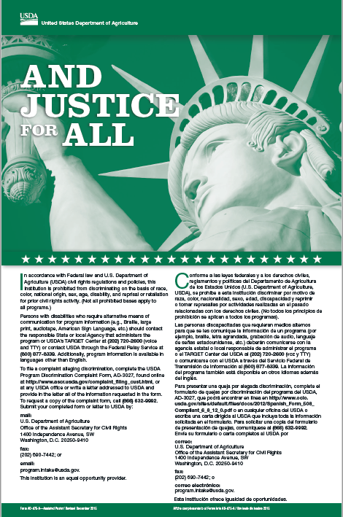
The ….and Justice for All poster is required to be displayed near the front entrance of your facility where the public can see it.
This poster does not go up with your labor law posters (which are for employees.)
Remember: Don’t post it where people will not see it.

Slide 15
Resolution of Noncompliance
Work with the parties involved to correct the situations and return to a level of compliance as quickly as possible
Attempt to achieve voluntary compliance.
Notify the state agency
Provide written notice
Corrective action must be completed
If unresolved within 60 days, FNB will forward the complaint to USDA

Slide 16

Reasonable accommodations
Recipients of federal funds must make reasonable accommodations for persons with disabilities.
Some food allergies can be considered disabilities which would need to be accommodated.

Slide 17


Civil rights training is an annual requirement to ensure that all staff and participants understand their responsibilities & prevent discrimination as much as possible.

Slide 18

What else is required?
Have information available in languages other than English if you have any parents that are not proficient in English.

Slide 19
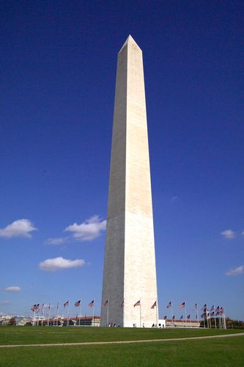
¿Dónde encuentras la declaración de no discriminación?
El en cártel"... y justicia para todos" se requiere anunciar en donde el publico lo pueda mirar cuando entran al edificio. Este cartel no se anuncia con los carteles de leyes laborales. (Cuales son para los empleados)
Recuerde: No anuncie el cartel en donde el publico no lo pueda mirar.

Slide 20
Traduccion en Espanol Disponible
Conforme a las leyes federales y a los derechos civiles, reglamentos y políticas del Departamento de Agricultura de los Estados Unidos (U.S. Departamento of Agricultura, USDA), se prohíbe a esta institución discriminar por motivo de raza, color, nacionalidad, sexo, edad, discapacidad y reprimir o tomar represalias por actividades realizadas en el pasado relacionadas con los derechos civiles.
(No todos los principios de prohibición se aplican a todos los programas).

Slide 21

Conflict Resolution
Why cover Civil Rights?
To resolve conflict
CACFP is a Federal program
To ensure all eligible participants are served without discrimination
To ensure that all staff know their duties and responsibilities related to civil rights
To be in compliance with CACFP regulations

Slide 22

Customer Service
Customers include:
Children in care
Adults in care
Parents or Guardians
Everyone should be treated with respect.
All participants need to have equal access to program benefits.

