Slide 1



CACFP Meal Service Training
AM Session
Family Nutrition Bureau
3401 Pan American Freeway NE
Albuquerque, NM 87107
(505)841-4856 or 1-800-EAT(328)-COOL(2665)
Website: www.newmexicokids.org

Slide 2
Training Overview
1
4
3
2
Documentation
Child and Adult Meal Pattern Requirements
Menu Planning
CN Labels and Product Formulation Statements
5
Resources
Notes:
We are going to go through each of these items listed on the slide. The At Risk programs should read the At Risk Handout on the new meal pattern webpage to learn about options they may choose to implement.
If you’re already making a lot of the changes that are allowed now, the optional best practices can help you build on the meal patterns and highlight areas where you may take additional steps to further improve the nutritional quality of the meals you serve.
All child care centers that are licensed or care for infants must review the infant section (no matter if claiming infant meals or not), as there are meal pattern and recordkeeping changes.

Slide 3
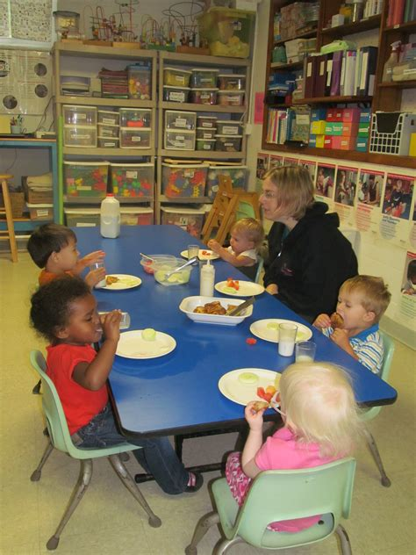

Child & Adult
Meal Pattern
Notes:
Let’s start with the Child and Adult Meal Pattern. Throughout this presentation we may mention adults in the CACFP, we are referring to those in Adult Day Care Settings.

Slide 4
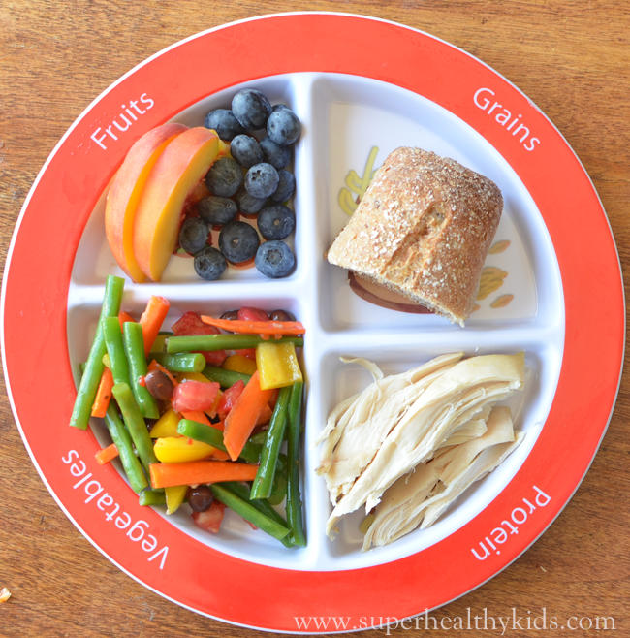
Child Meal Pattern Requirements Overview
Offer more vegetables and fruits
Increase whole grain-rich foods
Decrease added sugar, fat, and sodium

Slide 5
CACFP Breakfast Meal Pattern-Handout
Components (Select at least 3) | Ages 1-2 | Ages 3-5 | Ages 6-12 | Ages 13-18
Milk, fluid Unflavored Whole milk for children age 1. Unflavored Low Fat (1%) or Non-Fat (skim) for children 2-5. Unflavored Low Fat (1%) or Non-Fat (skim) or Flavored Non-Fat (skim) for children 6 and older. | ½ cup or 4 fluid ounces | ¾ cup or 6 fluid ounces | 1 cup or 8 fluid ounces | 1 cup or 8 fluid ounces
Vegetables and Fruits Vegetable(s) and/or fruit(s) or Full strength 100% fruit or vegetable juice (limit to 1/day) or An equivalent quantity of any combination of the above | ¼ cup ¼ cup | ½ cup ½ cup | ½ cup ½ cup | ½ cup ½ cup
Grains/Breads Whole grain-rich bread, or Whole grain-rich bread product (cornbread, biscuits, rolls, muffins, etc.), or Whole grain-rich, ready-to-eat breakfast cereal – dry, cold (no more than 6 grams sugar per dry oz.) Flakes or rounds Puffed cereal Granola or Whole grain-rich cooked cereal, cereal grain, and/or pasta or noodle products or An equivalent quantity of any combination of the above | ½ oz. equiv. = ½ slice ½ serving ½ cup ¾ cup ⅛ cup ¼ cup | ½ oz. equiv. = ½ slice ½ serving ½ cup ¾ cup ⅛ cup ¼ cup | 1 oz. equiv. = 1 slice 1 serving 1 cup 1 ¼ cup ¼ cup ½ cup | 1 oz. equiv. = 1 slice 1 serving 1 cup 1 ¼ cup ¼ cup ½ cup
OPTIONAL: Meat/Meat Alternate May be used to substitute an entire grain serving 3 times per week maximum | ½ oz. | ½ oz. | 1 oz. | 1 oz.
Notes:
Examples of vegetable for breakfast? Salsa or green chile w breakfast burrito – fresh tomatoes, spinach, mushrooms etc. in omlette, frittata, scramble etc. – EXPLAIN EGGS/PROTEINS AS AN EXTRA.

Slide 6
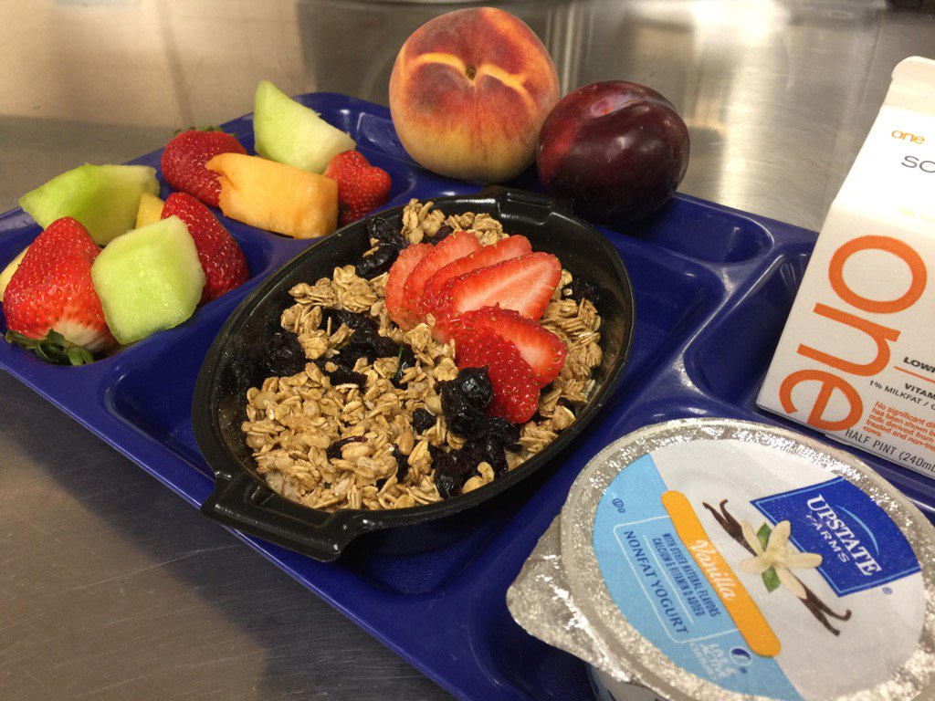
Breakfast
Milk
    6 fluid ounces or ¾ cup
  Vegetable, fruit, or both
    ½ cup
  Grains
    ½ serving or ½ ounce equivalent (3-5 year olds)
    Whole Grain
    Enriched
    Whole Grain-Rich

Slide 7
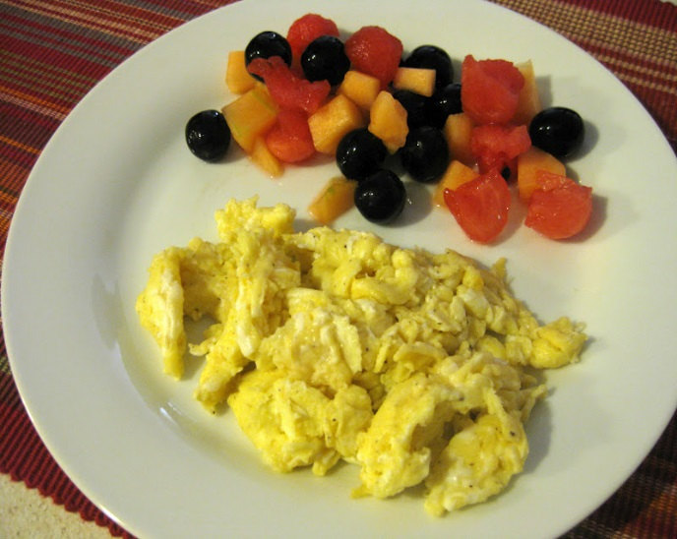
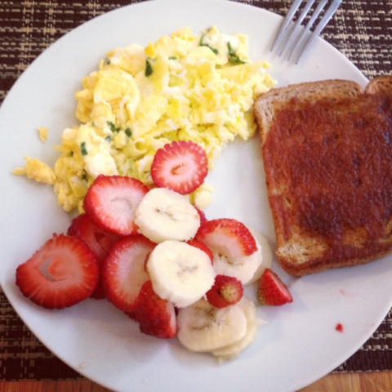
Breakfast
Meat/Meat Alternate(M/MA)
  Serve in place of the entire grains component
    maximum of 3 times per week
    Optional
  Menu
    Milk + Mixed Berries + Scrambled eggs
  Menu (recommended)
    Milk + Mixed Berries + Scrambled eggs + Whole Wheat Toast
Notes:
If decide

Slide 8
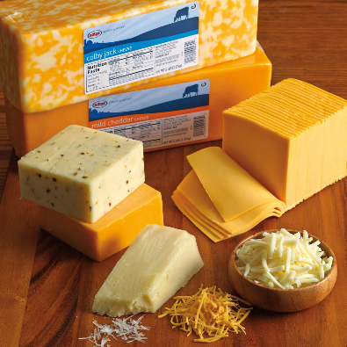
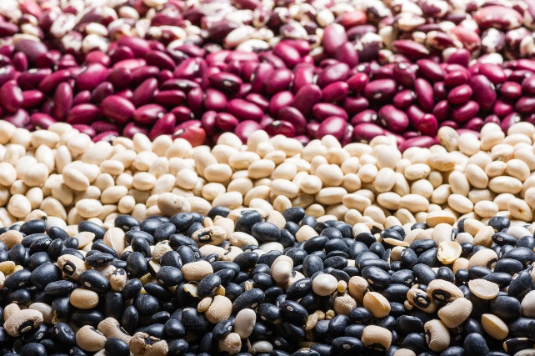


Meat/Meat Alternate

Slide 9
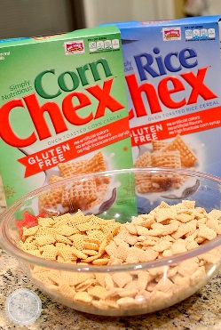


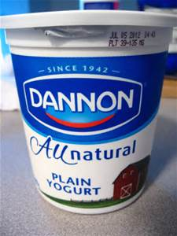
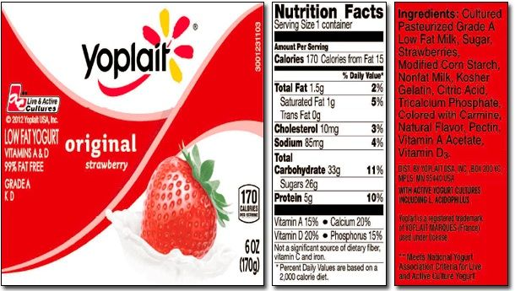

Limit Added Sugars
Breakfast cereals
  6 grams maximum sugar per dry ounce
Yogurt
  23 grams maximum sugar
  per 6 ounces
    **3.83 grams sugar per ounce
Notes:
The proposed rule would require breakfast cereals to meet all of the Supplemental Nutrition Program for Women, Infants, and Children (WIC) nutrient standards for breakfast cereals, which includes a sugar limit, a certain amount of iron, and various other nutrients.
The majority of commenters supported a sugar limit of some sort. However, commenters expressed concern that conforming to all the WIC nutrient standards would be too complicated because WIC approved cereals vary by State and a person cannot use a Nutrition Facts Label to determine whether a cereal is compliant with the WIC nutrient standards for breakfast cereal.
The final rule, therefore, focuses on our original intention of reducing added sugar consumption and only adopts WIC’s sugar limit on breakfast cereals. Breakfast cereals served in CACFP now must contain no more than 6 grams of sugar per dry ounce.

Slide 10
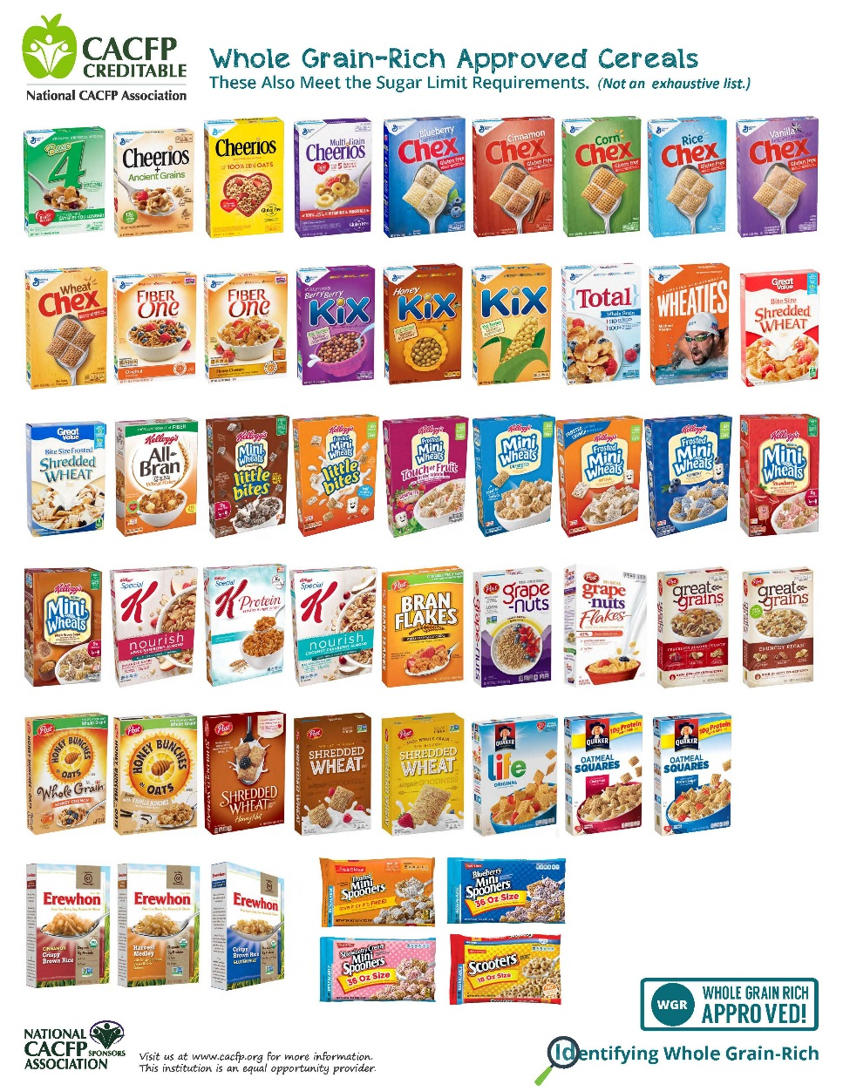
Cereals
Whole Grain-Rich
Types: Ready-to-eat, instant & regular hot cereal
No more than 6 grams sugar per dry ounce
Granola okay to serve if within sugar limit
Notes:
Both children and adults commonly enjoy breakfast cereals. Yet, some cereals are filled with added sugar. Therefore, to help reduce the amount of added sugar consumed by children and adults, all breakfast cereals, including ready-to-eat, instant, and regular hot cereal, must contain no more than 6 grams of total sugar per dry ounce.
You also cannot mix creditable cereals that meet the sugar limits with non-creditable cereals that are above the sugar limits in order to meet sugar limit requirements.

Slide 11
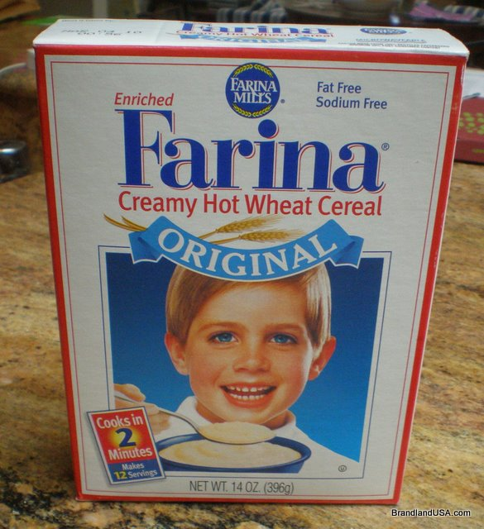
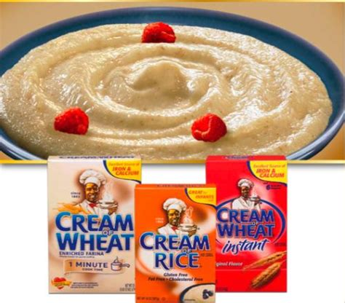
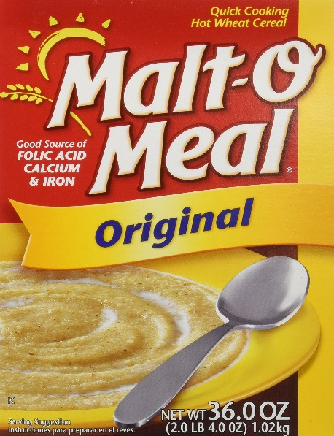
Grains
Enriched Cereals

Slide 12
Activity: Find the Breakfast Menu Problems
Monday | Tuesday | Wednesday | Thursday | Friday
Orange Juice Waffles Sausage | Ham & Eggs English Muffin Milk | Blueberries Cereal Milk | Banana Cereal Chocolate Milk | Breakfast Burrito: Eggs, Cheese, & Potato WW Tortilla Milk

Slide 13
CACFP Lunch & Supper Meal Pattern - handout
Components (Select all 5) | Ages 1-2 | Ages 3-5 | Ages 6-12 | Ages 13-18
Milk, fluid Unflavored Whole milk for children age 1. Unflavored Low Fat (1%) or Non-Fat (skim) for children 2-5. Unflavored Low Fat (1%) or Non-Fat (skim) or Flavored Non-Fat (skim) for children 6 and older. | ½ cup or 4 fluid ounces | ¾ cup or 6 fluid ounces | 1 cup or 8 fluid ounces | 1 cup or 8 fluid ounces
Vegetables Whole vegetable or full strength 100% vegetable juice (limit to 1/day) | ⅛ cup | ¼ cup total | ½ cup total | ½ cup total
Fruits Whole fruit or full strength 100% fruit juice (limit to 1/day) | ⅛ cup | ¼ cup total | ¼ cup total | ¼ cup total
Grains/Breads Whole-grain rich bread or Whole grain rich bread product (cornbread, biscuits, rolls, muffins, etc.,) or Whole-grain rich cooked pasta or noodle products or Whole-grain rich cooked cereal grains or An equivalent quantity of any combination of the above | ½ oz. equiv. = ½ slice ½ serving ¼ cup ¼ cup | ½ oz. equiv. = ½ slice ½ serving ¼ cup ¼ cup | 1 oz. equiv. = 1 slice 1 serving ½ cup ½ cup | 1 oz. equiv. = 1 slice 1 serving ½ cup ½ cup
Meat and Meat Alternates Lean meat, poultry, fish, tofu (firm), cheese or Large eggs or Cooked dry beans or peas or Peanut butter or soy nut butter or Other nut or seed butters or Peanuts or soy nuts or tree nuts or seeds* or Yogurt, plain or flavored (no more than 23 grams sugar per 6 oz.) or An equivalent quantity of any combination of the above | 1 oz. 1/2 egg ¼ cup 2 tbsp. ½ oz. = 50% 4 oz. | 1 ½ oz. 3/4 egg ⅜ cup 3 tbsp. ½ oz. = 50% 6 oz. | 2 oz. 1 egg ½ cup 4 tbsp. 1 oz = 50% 8 oz | 2 oz. 1 egg ½ cup 4 tbsp. 1 oz = 50% 8 oz
* Can only be used to meet half the meat requirement at lunch or supper. Serve with caution to children under five because of the risk of choking.

Slide 14
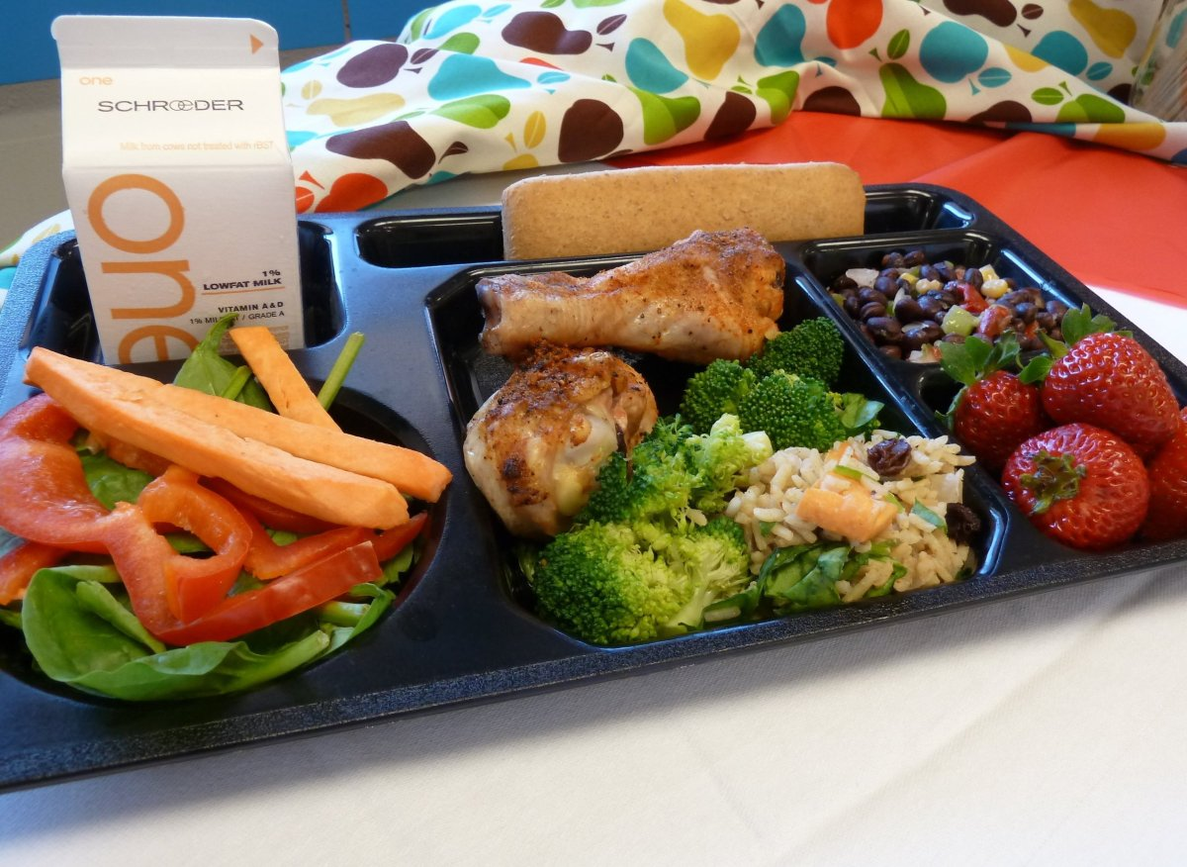
Lunch/Supper
3-5 Year Olds
  Meat/Meat Alternate
    1 ½ ounces
  Fruit
    ¼ cup
  Vegetable
    ¼ cup
  Grain
    ½ serving or ounce equivalent
  Milk
    ¾ cup
Notes:
If decide

Slide 15
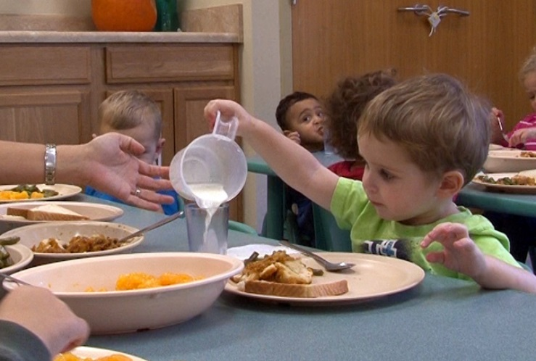
CACFP Meal Pattern
Reminders for Milk
1) Fluid Milk (Unflavored)
a) Whole milk = 12 through 24 months
b) 1% or Skim = 2-5 year olds
c) 2% (reduced fat) NOT creditable without doctor’s note
2) Q&A
a) The cook is aware that each child must be offered the minimum amount of milk (3/4 cup) for lunch. However, the teacher doesn’t want them to fill up on milk and only lets them pour ¼ cup. What would you do?

Slide 16

Milk
Transition Period (24-25 months)
Between 24-25 months of age:
  Start serving lowfat (1%) or non-fat (Skim)
    Mix whole milk + 1% milk
    Mix whole milk + Skim
  Circle 1% or Skim
    Menu Record Page
Notes:
Also, USDA recognizes that making an immediate switch from whole milk to low-fat or fat-free milk may be challenging for some children. Therefore, the updated meal pattern allows a one month transition period to switch from whole milk to low fat or fat free. During that transition period, you may claim reimbursement for meals served to children 24-25 months of age that include whole milk and mixtures of other milk.

Slide 17
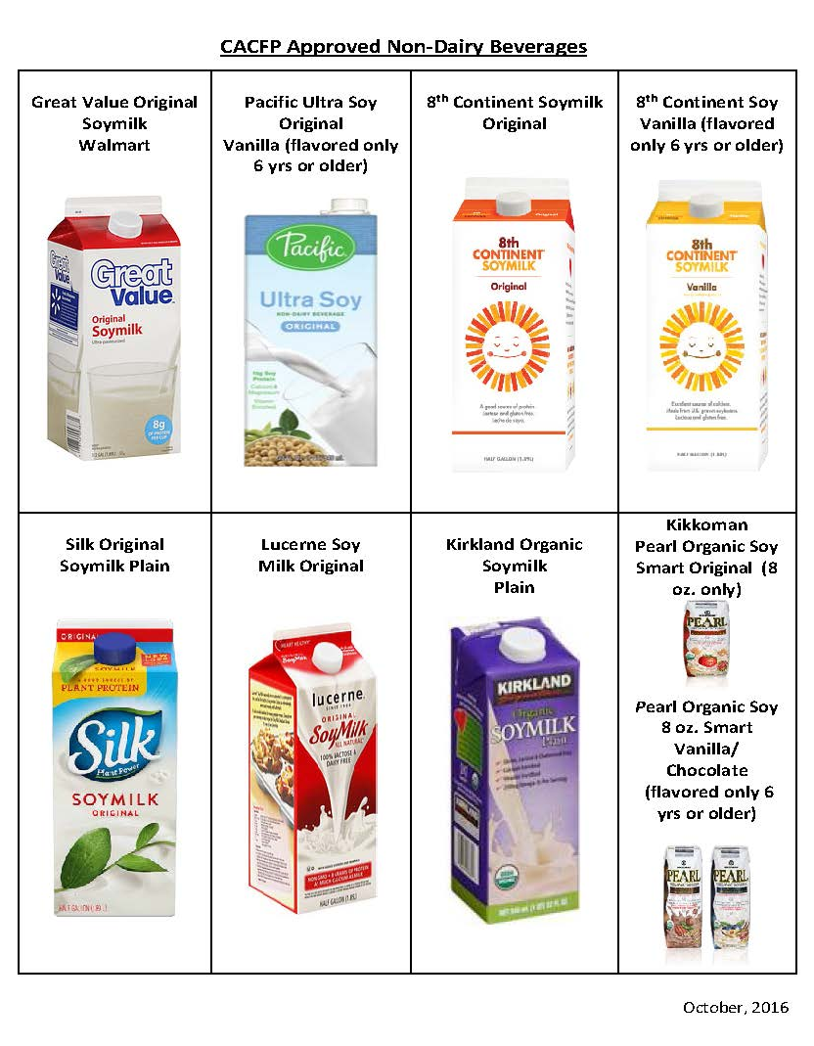
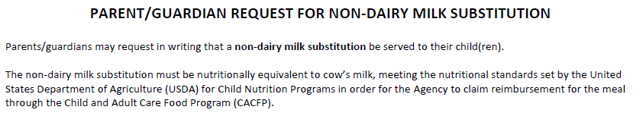
Non-Dairy Beverages
Age Group | Non-Dairy Beverages (nutritionally equivalent to milk)
Infants | None
1 Year Olds | Unflavored
2-5 Year Olds | Unflavored
Notes:
If you serve nondairy beverages, the nondairy beverage must be nutritionally equivalent to milk. The non-dairy beverage must be in-line with the requirements for unflavored versus flavored for each respective age group.
1 – 5 year olds must be served unflavored nondairy beverages
6+ year olds may be served flavored nondairy beverages.
Serving nondairy beverages (that are nutritionally equivalent to milk) can be a parent’s choice, per their with written request. The meals can be claimed regardless of who supplies it, the parent or provider. This only applies to nondairy beverages that are nutritionally equivalent to milk; all other components must be supplied by the Program unless justified by a medical statement.
The Parent/Guardian Request for Non-Dairy Milk Substitution form lists the non-dairy beverages that meet the milk standards. You can use this form to obtain the parent’s written request and to document the type of non-dairy beverage served to their child.

Slide 18
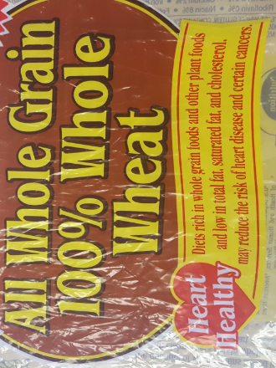
CACFP Meal Pattern
Is This a Whole Grain-Rich Bread?
Ingredients: Whole wheat flour, water, yeast, honey, and salt

Slide 19
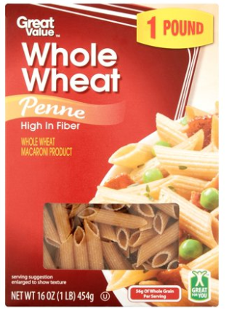
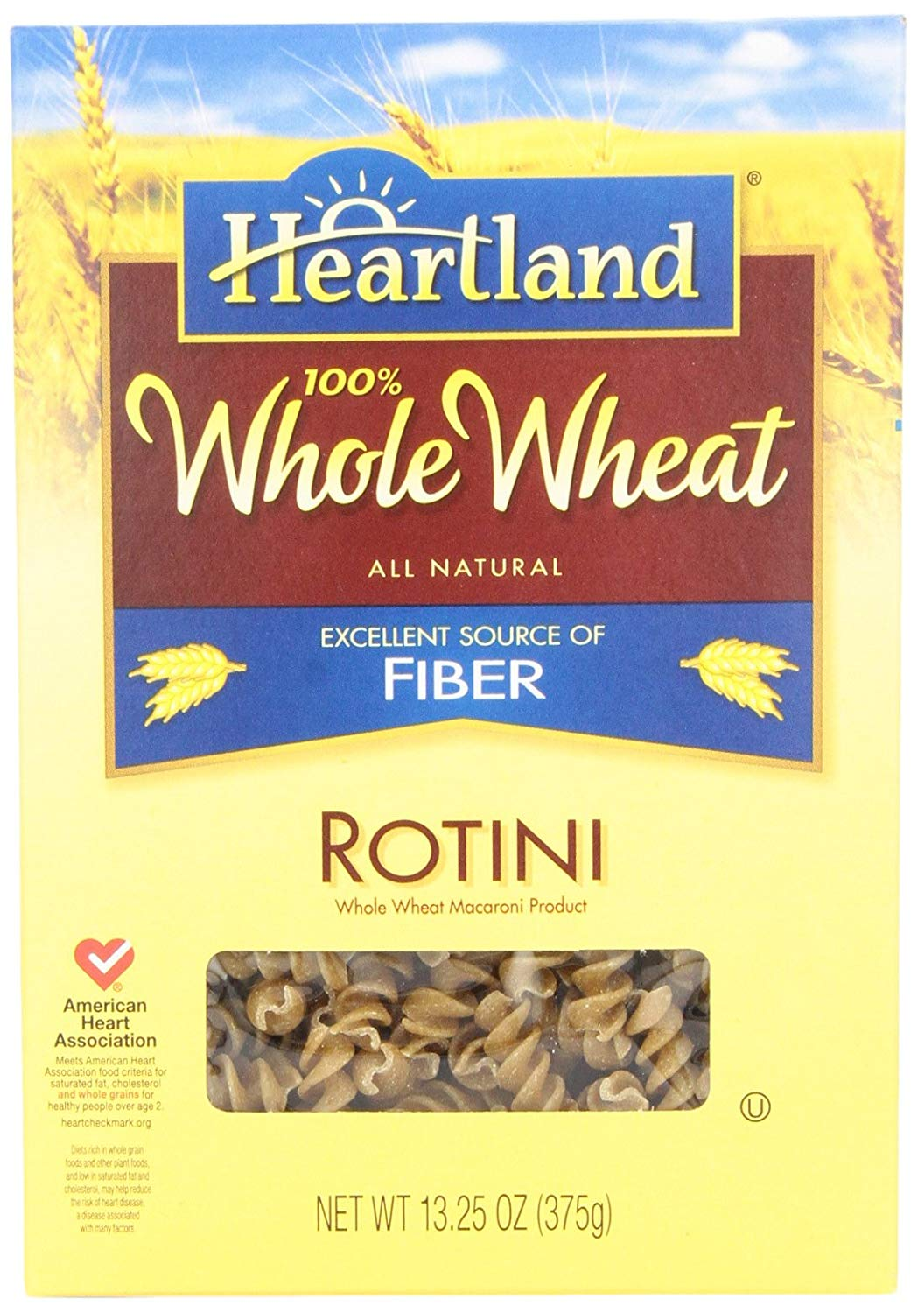
Grains: Pasta
Whole Grain-Rich?
Notes:
A variety of WW pastas at Walmart are $1.00/pound, which was only 2 cents more than the enriched versions.

Slide 20

CACFP Meal Pattern
Reminder for Crackers
INGREDIENTS: WHOLE GRAIN WHEAT, VEGETABLE OIL (SOYBEAN OR CANOLA OIL), SEA SALT.

Slide 21


Meal Pattern Reminders
Portion sizes
  Lunch/Supper for 6-12/13-18 year olds
    ½ cup vegetable + ¼ cup fruit
    1% or Skim Flavored Milk
  Recommended larger portions for older children
Five components
  Milk
  Meat/Meat Alternates
  Vegetables
  Fruits
  Grains
Notes:
The first change to the meal pattern is that there are now 5 meal components instead of four in the child and adult meal pattern: milk, meat/meat alternates, vegetables, fruits, and grains.
Fruits and Vegetables are now separate at lunch, supper, and snack. The presentation will show how this affects each meal later. They are still combined at breakfast.
All food components served must meet the minimum required sizes for each meal or snack served to receive reimbursement.

Slide 22
Activity: Find the Lunch/Supper Menu Problems
Monday | Tuesday | Wednesday | Thursday | Friday
Lunch
Taco Salad Crackers Pears Milk | Cherry Yogurt Tortilla Carrot Sticks Milk | Turkey & Cheese WW Sandwich Lettuce & Tomato Milk | Chicken Nuggets Sweet Potato Fries Vanilla Pudding | Cheese Pizza Garden Salad Milk
Supper
Fillet of Fish WW Mac and Cheese Broccoli Milk | Baked Chicken Brown Rice Pineapple Apricots | Tomato Soup Crackers Apple Slices Milk | Meatloaf Mashed Potatoes Zucchini Milk | Green Chile Chicken Enchiladas Pinto Beans Milk

Slide 23
CACFP Snack Meal Pattern-handout
Components (Select any 2 of the 5) | Ages 1-2 | Ages 3-5 | Ages 6-12 | Ages 13-18
Milk, fluid Unflavored Whole milk for children age 1. Unflavored Low Fat (1%) or Non-Fat (skim) for children 2-5. Unflavored Low Fat (1%) or Non-Fat (skim) or Flavored Non-Fat (skim) for children 6 and older. | ½ cup or 4 fluid ounces | ½ cup or 6 fluid ounces | 1 cup or 8 fluid ounces | 1 cup or 8 fluid ounces
Vegetables Whole vegetable, or Full-strength 100% vegetable juice (limit to 1/day) | ½ cup | ½ cup | ¾ cup | ¾ cup
Fruits Whole fruit, or Full-strength 100% fruit juice (limit to 1/day) | ½ cup | ½ cup | ¾ cup | ¾ cup
Grains/Breads Whole grain-rich or enriched bread, or Whole grain-rich or enriched bread product (cornbread, biscuits, rolls, muffins, etc.), or Whole grain-rich enriched or fortified ready-to-eat breakfast cereal (no more than 6 grams sugar per dry oz.) Flakes or rounds Puffed cereal Granola Whole grain-rich, enriched fortified cooked cereal, cereal grain, and/or pasta or noodle products or An equivalent quantity of any combination of the above | ½ oz. equiv. = ½ slice ½ serving ¼ cup or ⅓ oz. ½ cup ¾ cup ⅛ cup ¼ cup | ½ oz. equiv. = ½ slice ½ serving ⅓ cup or ½ oz. ½ cup ¾ cup ⅛ cup ¼ cup | 1 oz. equiv. = 1 slice 1 serving ¾ cup or 1 oz. 1 cup 1 ¼ cup ¼ cup ½ cup | 1 oz. equiv. = 1 slice 1 serving ¾ cup or 1 oz. 1 cup 1 ¼ cup ¼ cup ½ cup
Meat and Meat Alternates Lean meat, poultry, fish, tofu (firm), cheese or Large eggs or Cooked dry beans or peas or Peanut butter or soy nut butter or Other nut or seed butters or Peanuts or soy nuts or tree nuts or seeds* or Yogurt, plain or flavored (no more than 23 grams sugar per 6 oz.) or An equivalent quantity of any combination of the above | ½ oz. ½ egg ⅛ cup 1 tbsp. ½ oz. 2 oz. or ¼ cup | ½ oz. ½ egg ⅛ cup 1 tbsp. ½ oz. 2 oz. or ¼ cup | 1 oz. 1/2 egg ¼ cup 2 tbsp. 1 oz. 4 oz or ½ cup | 1 oz. ½ egg ¼ cup 2 tbsp. 1 oz. 4 oz or ½ cup
* Serve with caution to children under five.

Slide 24
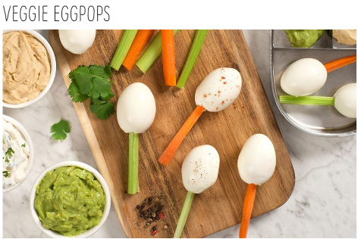
Snack
Select two of the five food components:
  1. Milk
  2. Meat/Meat Alternates
  3. Vegetables
  4. Fruits
  5. Grains
  Example: Veggie Egg Pops

Slide 25
Activity: Find the Snack Menu Problems
Monday | Tuesday | Wednesday | Thursday | Friday
Milk Orange Juice | Bagel and Cream Cheese | Celery Sticks Baby Carrots | Hard-boiled Egg Ham cubes | Strawberry Yogurt

Slide 26


DRINK
WATER

Slide 27
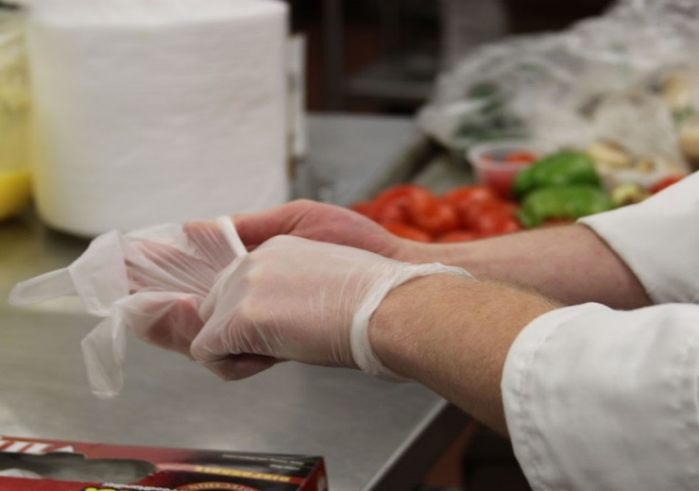

Basic Food Safety
Wash hands often and wear gloves!
Use a food thermometer
Sterilize cutting boards and surfaces
Wash/scrub melon rinds with water
More information:
  https://theicn.org/icn-resources-a-z/produce-safety/
Notes:
Refer to handout 5.
Wash hands in warm running water for 20-30 seconds.
Hot foods should be held at 140 degrees and cold foods should be stored at 41 degrees.

Slide 28

Safe Food Handling
Stored foods must be sealed, labeled and dated
“First In/First Out” (FIFO)
Thermometers must be in both refrigerator and freezer
Until served:
  Cold foods should be kept at 41º F ( 5º C) or lower
  Hot foods should be kept at 135º F / 57º C or higher

Slide 29
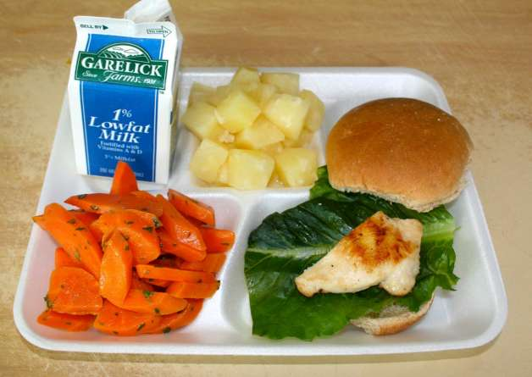
Menu Planning

Slide 30
Meal Requirements
Non-Creditable Foods
Creditable Foods
Foods that may be counted toward meeting the requirements for a reimbursable meal
Based on:
  USDA Food Buying Guide
  NM Food Purchasing & Production Guide
  USDA CACFP Crediting Handbook
  USDA Foods Fact Sheet
  CN Label/Product Formulation Statement
Foods that cannot be counted toward the meal pattern requirements
Common Non-creditable foods:
  Bacon
  Jell-O
  Pudding
  Potato chips
  Beef jerky
  Ice cream
Usually high in fat, sugar, or salt but enhance the flavor of food.
Notes:
Creditable foods are found in all the listed above resources.
If in question, call the NET department so meals are reimbursable.
Potato chips cannot be counted as a vegetable and are not reimbursable
Jello cups with fruit – just the fruit is reimbursable if in the correct portion size

Slide 31
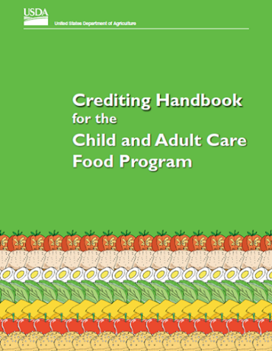
CACFP Resource
Creditable Foods (Revised edition coming soon)

Slide 32
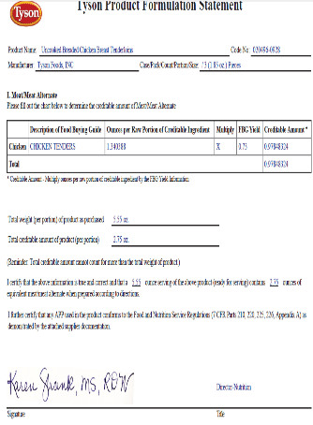
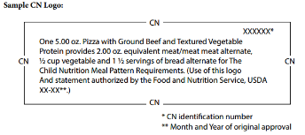
Meat/Meat Alternates
Combination Foods
Product Formulation Statement
Products
  Store-bought combination foods
  Soy Products
  Tofu
Keep documentation in binder
Danger=accepting delivery of products without CN label or PFS
Danger=not following serving instructions
Notes:
A current requirement that is not changing are CN labels (or product formulation statements) must be on file for any store-bought combination item such as chicken nuggets, pizza, etc. This will also include any soy products as well.
In the past, if agencies were serving store-bought combination food items with no documentation, we’ve allowed agencies to submit the CN labels as corrective action. Effective October 1, 2017, starting with the FY 2018 reviews, any meal containing a commercially prepared combination food item that does not have proper documentation will be disallowed. As part of corrective action, your agency will still need to submit proper documentation in order to continue serving the item.
Also, you cannot claim meals that include a store-bought combination food without the proper documentation on file.
Examples of store-bought combination foods are pizza, chicken nuggets or fish sticks.

Slide 33
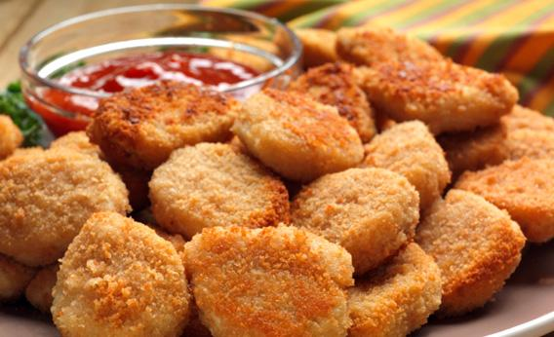
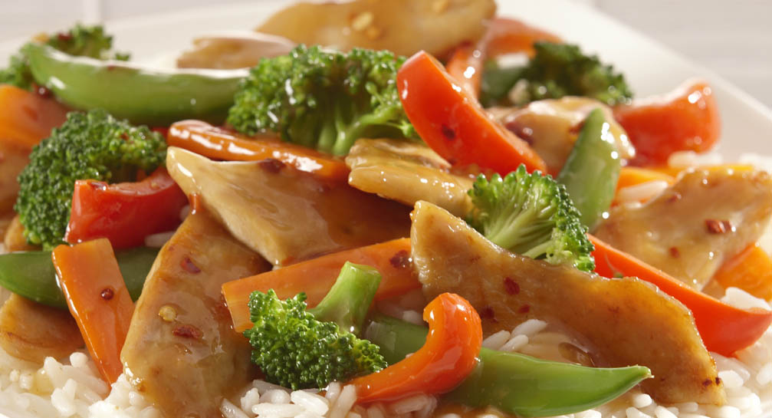
CN Label = Healthy Food?
CN labels are NOT the healthiest food option!
  Processed meat / meat alternate products
    High in sodium, fat and calories
    Many fillers & by-products
Scratch cooking is a healthier option
Q&A: What menu option below is healthier?
is iOR

Slide 34

New Mexico Food Purchasing and Production Guide -- Updated
Small quantity food production
  5-100 servings
  Color-coded sections
Meat/Meat Alternate Section
  2 ounce serving size
  1 ½ ounce serving size
Grains/bread Section
  Serving size
  Ounce Equivalents
Fruit and Vegetable Section
  ½ cup serving size - breakfast
  ¼ cup serving size

Slide 35
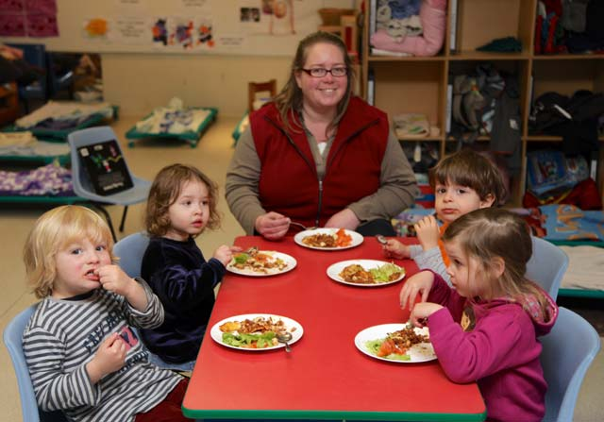
Family Style Meal Service
New Mexico CACFP requirement
  Teacher eats the same meal & portion as the child and encourages trying all foods
  Food is offered and therefore reimbursable even though child may choose not to eat it

Slide 36

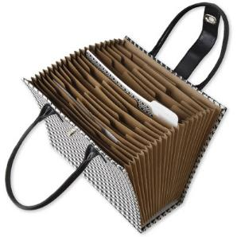
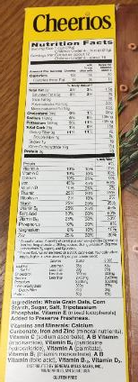
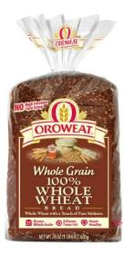
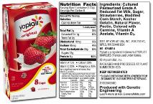
Documentation
Product Information
Keep labels of items purchased
and served
Binder or Other Organized System
  Keep updated
Menu planning made easier
  Buy same items
Notes:
Because you are required to keep a lot of product information on file, we recommend keeping labels in a binder or accordion file.
The binder (or some other organized system) must reflect what you are currently purchasing. Keep this information updated and add new products when purchased. During a CACFP review, the CACFP consultant will be looking at the binder and looking at your receipts to verify these products were purchased and available to be served.
Having a binder of food items that meet the WGR requirements and cereal and yogurt sugar limits can be to your advantage. Once you find a product that meets CACFP requirements, we encourage you to continue to purchase those same products. This may help make menu planning and shopping easier because you know what items you can serve and purchase. You no longer need to hunt for products that meet requirements or read labels at the store each time you are shopping.

Slide 37

Menu Documentation
Cereals
Write the specific name of cereal(s) on menus
  Verifies if within the sugar limit and/or whole grain-rich
Notes:
Now let’s discuss how to document the types of cereals served at your program.
Programs must document the specific name of cereal(s) on menus (Cheerios, Rice Krispies, Life Cereal). If the cereal you serve is whole grain, then you must write the name of the cereal with WG in front of the name. For example, WG Cheerios.
If you have multiple classrooms that get their own breakfast, and choose their own cereal, then you could list all possible cereals on the menu (at the top or bottom). It is recommended to only buy certain types of cereals so they can be listed on the menu. If counted as whole grain-rich (WGR) item for day, then all cereals must be WGR. This will be discussed later.

Slide 38


Nutrition Education
Monthly CACFP Requirement
Use Nutrition Education Form
1 Nutrition Education activity per month
Keep filed for administrative review
Nutrition Merry-Go-Round
New Mexico Family Nutrition Bureau
Nutrition Education and Training Section
3401 Pan American Freeway NE
Albuquerque, New Mexico 87107
Notes:
Nutrition Ed Requirements are:
1x/month for 1 more classes – We recommend doing a nut ed activity in every class (modify for age)
Documented on form and kept on file for admin review
Mail into FNB to Teresa Jan/April/Sept
Nutrition Education Web Resources – Go over Handout #6

Slide 39

Family Nutrition Education Staff
Pam Mitchell Manager (505) 841-4853
pam.mitchell@state.nm.us
Teresa Taylor Nutritionist (505) 841-4854
  teresa.taylor@state.nm.us
Laura Spencer Nutritionist (505) 841-4852 laura.spencer2@state.nm.us

Slide 40

Thank You for Being a Sponsor of the Child and Adult Care Food Program!

Slide 41
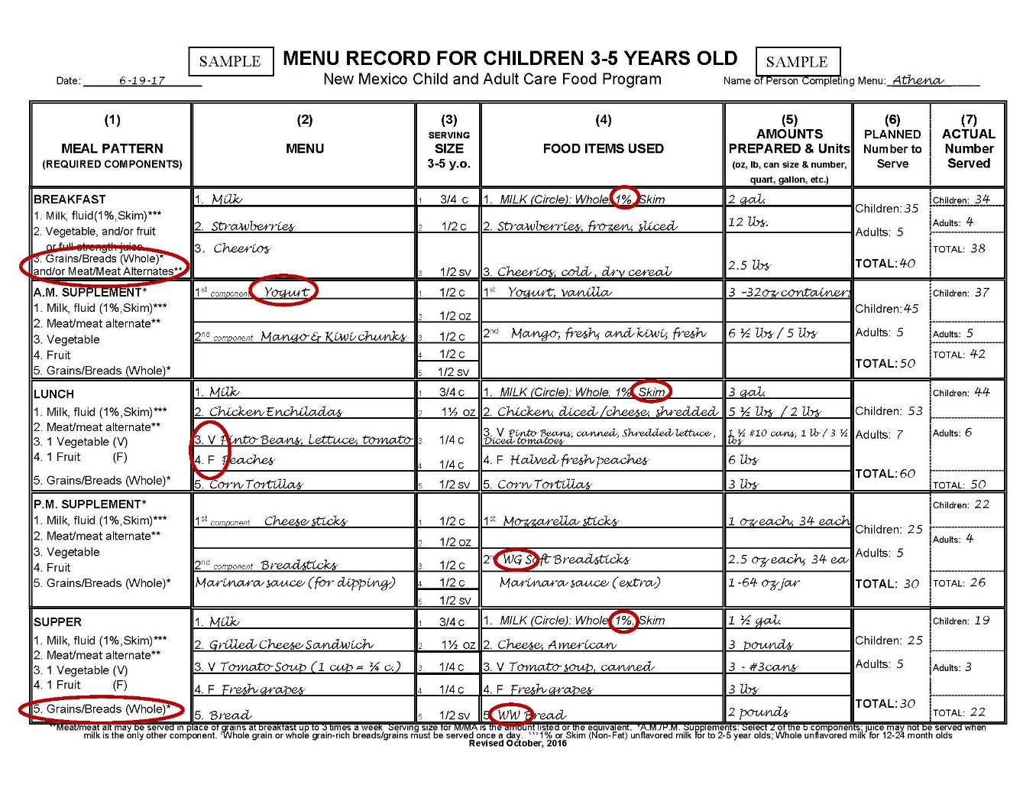
CACFP Meal Pattern Review
Look at your handout and find the reimbursable meals?

