Slide 1



Renewal Applications
For FY 2019-2020

Slide 2

Requirement for Renewal Applications
Each year participating organizations must submit a renewal application
Approval includes a budget for the new year
Approval is needed for changes and updates
The previous year’s spending pattern is examined
Annual certification is required.

Slide 3


Renewal Applications
Required in order to participate in CACFP for the new fiscal year; Oct 1, 2019 to Sept 30, 2020
Due dates:
  July 20, Independent Centers
  August 15, Sponsoring Organizations
Available on-line now @ newmexicokids.org
Form A-4
Late submissions not accepted after Sept 15, 2019

Slide 4

Renewal Application Form
Found at www.newmexicokids.org/focus-materials/#115-cacfp-centers-forms
At the website choose Caregivers and Educators
Then Forms, Documents and Materials Library
Then CACFP Centers Forms & Form A-4

Slide 5


Some things to know before you start
Please type in your responses on the computer
Use Adobe Acrobat as your software to open & read the file. You can download Adobe Reader free of charge
DO NOT print the form & fill it out with a pen or pencil
Do print out the form after it has been filled in completely and Sign it and Mail it in.

Slide 6

Renewal Application Checklist
Form A-4; 2 pages
Staff Training
  Training at one of the State agency sessions required for the instructor who will provide staff training at your location
  Submit Date and name of the person who will train your staff
  Indicate State Agency agenda or developing your own.
Submit a copy of your training certificate; Not the original

Slide 7

Financial
Agency’s Accounting Method; Cash or Accrual?
Proposed budget; Keep it the same or include a new proposal. Make sure your proposed numbers are supported by Form 95 documentation of actual expenses or some other valid explanation
Form 95 – CACFP Income & Expense Tracking form- Be sure to use the latest version. Reports submitted on the old form will be rejected.

Slide 8

Financial Continued
Agency P & L for most recent fiscal year. If the report shows a loss, include a Balance sheet and audit if you have one.
Municipal government organization are exempt.
  City, County, Tribal
Public Schools, Universities, military bases are exempt.
Charter schools & private schools need to submit a P&L
Submit a copy of your audit if required to have an audit

Slide 9

Civil Rights Data Collection
Form – 036 – One page
Collect data from any recent time period
Be sure the numbers reported under Ethnicity and the numbers reported for Race, each add up to the total enrollment.

Slide 10
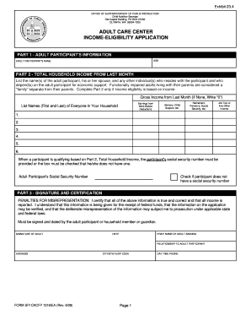
IEA option
Choose one of the options
  Count 1 time a year in October & use the numbers the rest of the year. Numbers will be consistent for entire year.
  Collect and count forms each month. Numbers will vary
Be sure you are using the most recent version of the form
Use a roster of enrolled students regardless of which option you choose.

Slide 11
Financial & Administrative Policies and Procedures
This area caused the most organizations the most trouble last year.
If you are responsible for developing these policies & procedures at your organization and have not yet attended the workshop, FNB STRONGLY encourages you to attend a workshop on developing these policies.
If you did not hear back last year that your policies had problems, it does not mean they were well done.

Slide 12

Multiple Site Form
For Organizations with more than 1 location
Form 002 is required; Lists all sponsored facilities. Lists should be in Alpha order & match information about how many sites from management plan AND match sites reported on the Civil Rights Data collection form AND match the monitoring schedule AND match EPICS report 640

Slide 13

Facility Site Information
Indicate if the information is correct & current or needs updating.
Multiple sites only: Use Report 640 from EPICS to indicate which sites are not current (if any)
Attach Form A-3 with Current information for each site
No need to submit Form A-3 if all information is current

Slide 14

Management Plan
All organizations (except brand new institutions) need to submit management plans this year. Form A-2
Plan to spend a some time on completing this plan.
Many things are different from previous versions of the plan
Organizations who have 2017 version on file, do not need to submit a new one. However financial & administrative policies & procedures will need to be submitted.

Slide 15

Management Plan
Please open the form on Adobe Acrobat & TYPE in your responses.
Please use the legal name of the organization
DUNS number should be on last year’s approval
DOBs are required for Principles

Slide 16

Management Plan; Financial Viability
Fiscal Year – Your organization’s 12 month reporting period
List Month & Day of start and end of the Fiscal Year
Programs & Public Funding + Past public funding
Does organization require an audit?
  When was it done? What period was covered? FY?
Accounting functions done by???
Accounting method? Cash? Accrual?
Form 990 and Agency P&L

Slide 17

Management Plan;
Accountability – Checks & Balances
Policies & Procedures
Policies & Procedures
Cash management
Banking
Budget
Claims
Separation of duties
Travel
Donations
Audit
Purchasing
Code of Conduct
Inventory
Employee Compensation

Slide 18
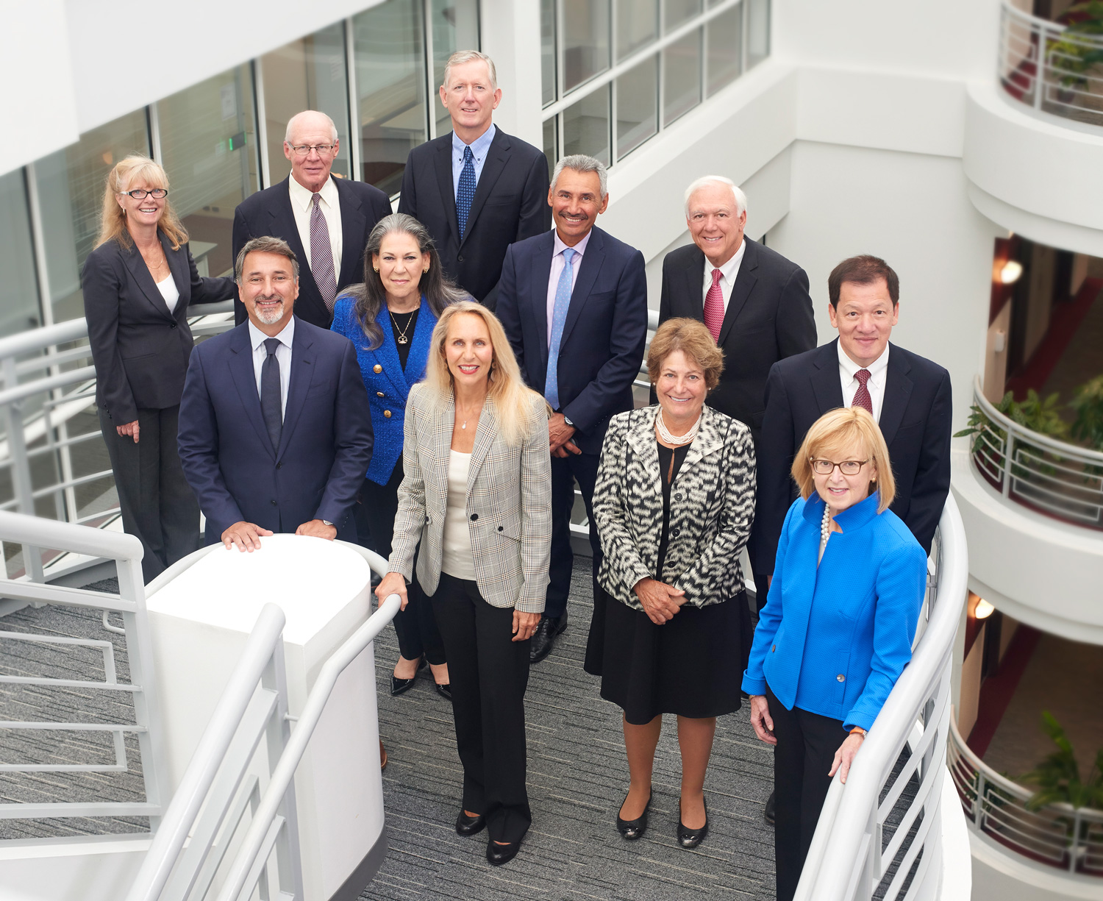
Management Plan - Accountability
Non-profit 501-C-3 organizations
  990 Report unless exempt
  Board of Directors info. Form 001
  Board meeting minutes
Sponsors of multiple sites
  Multiple Site addendum Form #002
  Monitoring plan
  Copy of outside employment policy

Slide 19
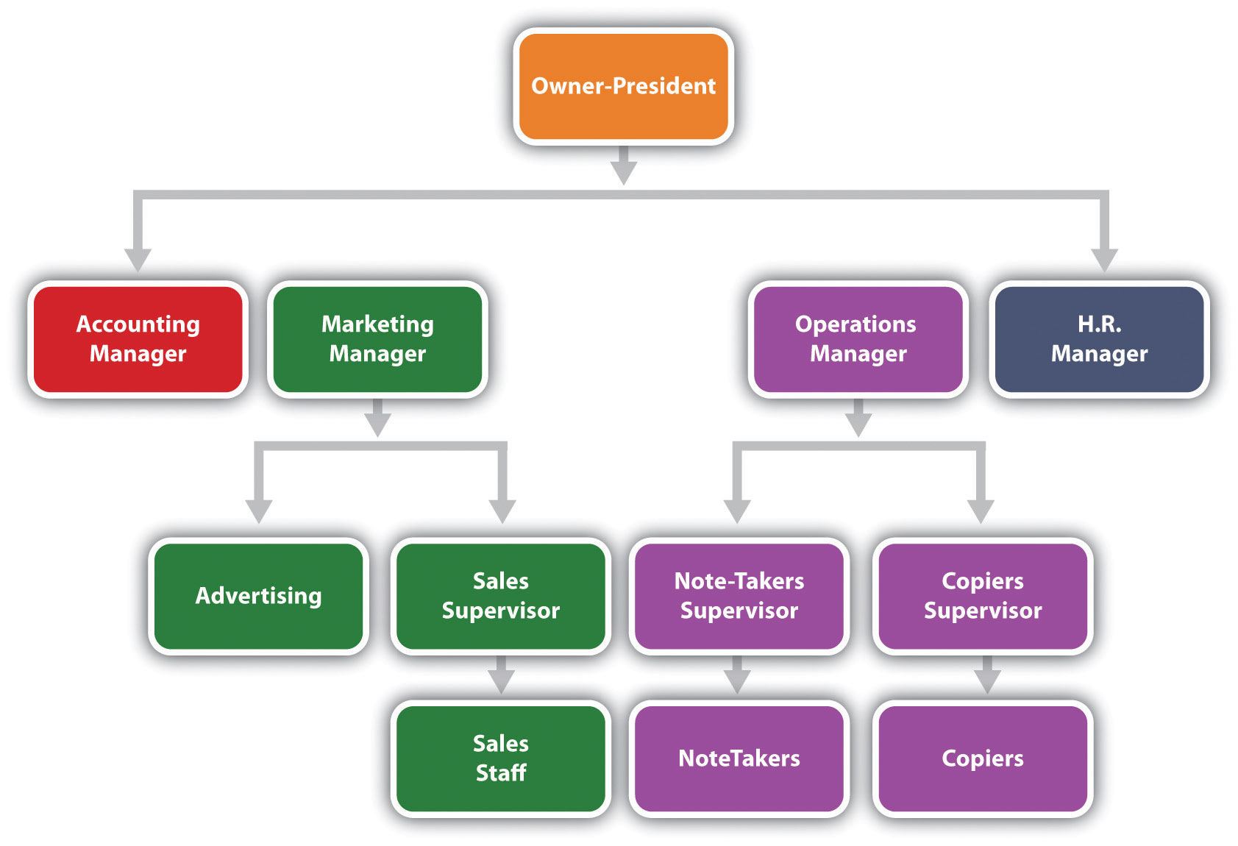
Management Plan;
Organizational Structure
Org Chart
Chain of Command for larger governmental organizations.

Slide 20

Management Plan:
Administrative Capability
Experience operating publically funded programs
Education or training
Attendance at State sponsored training
Assignment for notifying FNB of changes

Slide 21

Management Plan –
Administrative Duties
Responsibility chart for CACFP Administrative Duties
Monitoring function not needed by independent institutions
All Admin labor costs requested should be detailed on this chart.
Total Admin labor requested on budget should not exceed labor cost totaled in this table

Slide 22

Staff Training
Menu Record Book
Meal Counts
Attendance
IEAs
Nutrition Ed
Expense tracking
Menu Planning
Creditable Foods
Meal Pattern
Monitoring
Family style dining
Claim for reimbursement
Civil Rights
Enrollment forms
OR use the State Agency composed Agenda

Slide 23

Management Plan; Daily Operations
Process for collecting claim information
Method for taking attendance
Method for taking meal counts
Meal preparation method
Documentation of meal eligibility
Meal service style
IEA Processing
#8 & #9 not needed.

Slide 24

Management Plan
Nutrition Education Planning Chart Form N- 038
Certification statement
Signature of Principle

Slide 25

Renewal Application
Vended meal service
Forms 050, 052 and/or 054 need to be submitted for vended programs
Specific forms needed depends on the size and scope of the organization’s operations
Keep in mind having a FSM company operating your food service is different than traditional vending.

Slide 26

Certification
Certification page is attesting to the information listed and all other items submitted, being correct.
Authorized representative signs the form
If different; the CACFP Coordinator should also sign the form.
Be sure to include correct DOB information for each person.

Slide 27
How much do you need to send in for your renewal application?
Your renewal application should consist of:
  2 pages Application checklist
  1 page copy of training certificate
  3 pages; Form 95 Do not need each month’s detail
  1-4 pages Agency P&L
  1-2 pages Civil Rights Data Collection (depending on #sites)
  3-12 pages of Financial Policies & Procedures
  5 pages Management plan

Slide 28

You may also need:
New proposed budget; If your percentages have changed
Balance Sheet if P&L shows a loss for the year
Copy of your Audit
990 Report for 501 c (3) organizations
Board minutes - Nonprofits
Organizational chart- Proprietary
Form 002 for Sponsors of multiple sites
Form A-3 to update site information
Form 050, 052 or 054 for Vended programs

Slide 29


Your renewal application should be about 16 to 30 pages
More if you are submitting an audit or your P&L is extra large
More if you need to submit any of the additional items for vended programs, multiple sites, or need a change in budget or need to update site information
More if you have exceptionally detailed policies and procedures
More if you need to send in a copy of your 990
Like this
Not this

Slide 30
Please do not submit
Copies of your business license
Monthly pages for Form 95
Copy of your or our training agenda
Training certificates for everyone who attended training
Copies of Cooks Academy certificates
Reports showing monthly budget to actual expenses
Civil Rights form 35 (Long form - 2 pages)
IEA Rosters
Sanitation Inspection reports

