Slide 1



2019 CACFP
Infant Meal Pattern
Training
Notes:
This training has been adapted from the training created by the Institute of Child Nutrition, or ICN. ICN is an organization that has been funded by USDA to provide training on new meal pattern requirements.
Also, the ICN has many resources your program can use to be successful in the CACFP. This includes sample menus, recipes, and training videos.

Slide 2
Training Overview
1
4
3
2
Requirements at Each Meal, 6-11 mo.
Infant Meal Pattern Overview
Breastfeeding Promotion
Requirements, Birth – 5 mo.
5
Documentation, Training Resources
Notes:
We are going to go through each of these items listed on the slide. The At Risk programs should read the At Risk Handout on the new meal pattern webpage to learn about options they may choose to implement.
If you’re already making a lot of the changes that are allowed now, the optional best practices can help you build on the meal patterns and highlight areas where you may take additional steps to further improve the nutritional quality of the meals you serve.
All child care centers that are licensed or care for infants must review the infant section (no matter if claiming infant meals or not), as there are meal pattern and recordkeeping changes.

Slide 3

Infant Meal Pattern Requirements
Notes:
Last, training will go through new infant meal pattern requirements. Updates are based on the scientific recommendations from the National Academy of Medicine, the American Academy of Pediatrics and stakeholder’s input.

Slide 4
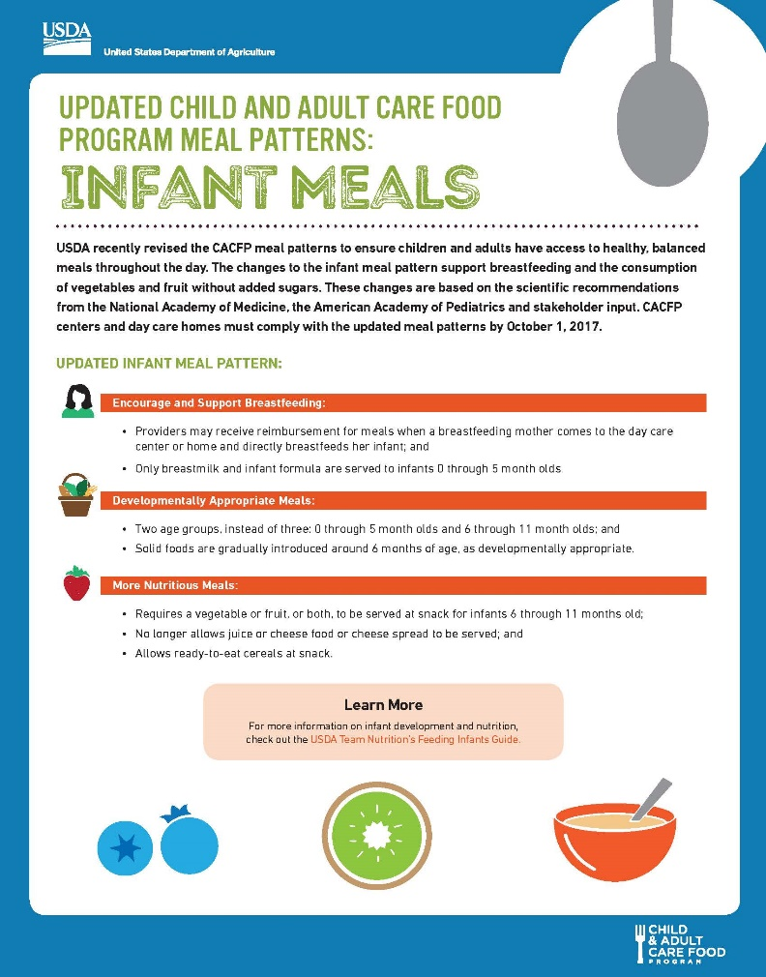
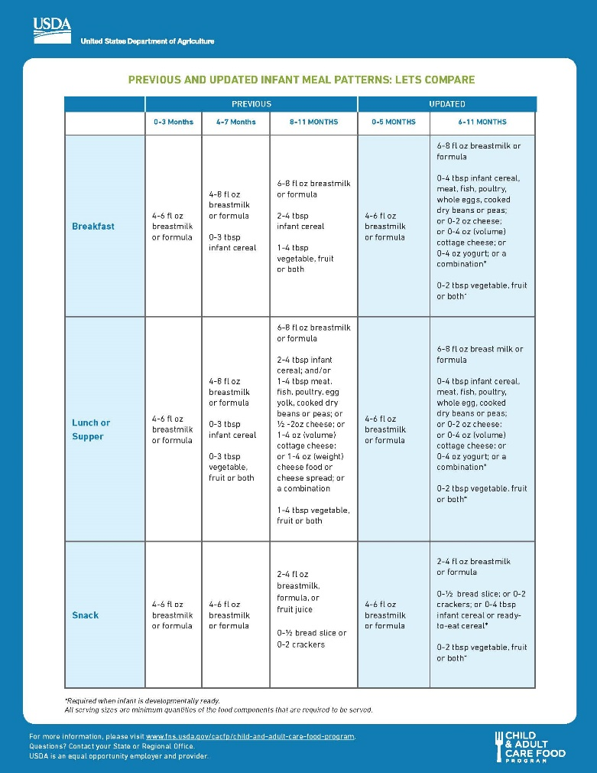

Meal Pattern
Infant Meals
Handout
Notes:
This handout from USDA summarizes the changes for the components and on the backside it compares the old meal pattern versus new meal pattern.
Specifically, the changes provide:
• Wider varieties of protein options
• More vegetables and fruits
• Increase whole grain rich foods
• Less added sugar and saturated fat

Slide 5

Infant Meal Pattern
 | Birth to 5 months | 6 to 11 months
Breakfast | 4-6 fl. oz. Formula¹ or Breast milk^{2,3} | 6-8 fl. oz. Formula¹ or Breast milk^{2,3} and 0-4 Tablespoons infant cereal,^{1,4,5} meat, fish, poultry, whole eggs, cooked dry beans or peas; or 0-2 oz. cheese; or 0-4 oz. (volume) cottage cheese; 0-4 oz. yogurt⁶, or a combination⁴ → IRON and 0-2 Tablespoons fruits or vegetables or both⁴
Lunch or Dinner | 4-6 fl. oz. Formula¹ or Breast milk^{2,3} | 6-8 fl. oz. Formula¹ or Breast milk^{2,3} and 0-4 Tablespoons infant cereal,^{1,4,5} meat, fish, poultry, whole eggs, cooked dry beans or peas; or 0-2 oz. cheese; or 0-4 oz. (volume) cottage cheese; 0-4 oz. yogurt⁶, or a combination⁴ → IRON and 0-2 Tablespoons fruits or vegetables or both⁴
Supplement (Snack) | 4-6 fl. oz. . Formula¹ or Breast milk^{2,3} | 2-4 fl. oz. Formula¹ or Breast milk^{2,3} and 0- ½ slice bread^{4,5} tortilla, or 0-2 crackers^{4,5} or 0-4 tablespoons infant cereal¹ or ready to eat cereal^{4,5,7} and 0-2 Tablespoons fruits or vegetables or both⁴
Handout

Slide 6

Breastfeeding & Infants
We promote breastfeeding by:
  Delaying solids until around 6 mo.
We promote breastfeeding by allowing reimbursement when:
  Infant is served expressed milk
    Keep refrigerated at center 72 hours
  Mother breastfeeds her infant on-site
    Also applies to staff with enrolled infants
Notes:
The CACFP continues to promote breastfeeding and serving breastmilk to infants. As in the past, a program can be reimbursed when the infant is served expressed breastmilk while in your care. A new change is that your program may also be reimbursed when the mother breastfeeds her infant on-site. This means that a mom can visit her infant and breastfeed at a meal or snack, and it is reimbursable as long as all other infant meal pattern requirements are met by the Program, which will be reviewed later.

Slide 7

Birth – 5 months
Just breastmilk or iron-fortified infant formula (IFIF)
Parent-brought or “house” IFIF
  Must be FDA regulated (US-made)
Introducing solid foods too early:
  may cause choking
  consume less breastmilk or formula
  increases risk of obesity
Notes:
Introducing solid foods is a very important step for infants. Introducing solid foods too early may cause infants to:
Choke on the food because they are not physically able to consume solid foods,
Consume less breastmilk or formula and not get enough calories and other nutrients for proper growth and development, or
Could lead to increased risk of obesity due to the infant being fed foods high in calories, fat, etc. which is replacing the nutrients the infant needs that they would be getting from breastmilk or formula.
Therefore, it is important to serve solid foods to infants when they are developmentally ready.

Slide 8

Introducing Solid Foods
Serve solid foods as puree when infants are developmentally ready (“around” 6 mo.)
Always consult with parents or guardians / pediatrician before starting solid foods
Notes:
Some infants may be developmentally read to eat solid foods before 6 months of age, some at 6 months of age, and some after 6 months of age. When an infant starts eating solid foods before 6 months, follow the 6-11 month old meal pattern.
We want to remind you to work with parents or guardians to ensure that all newly introduced foods are appropriate for each individual infant and are consistent with their eating habits and developmental readiness. Always consult with parents or guardians about when and what solid foods to introduce to infants.

Slide 9
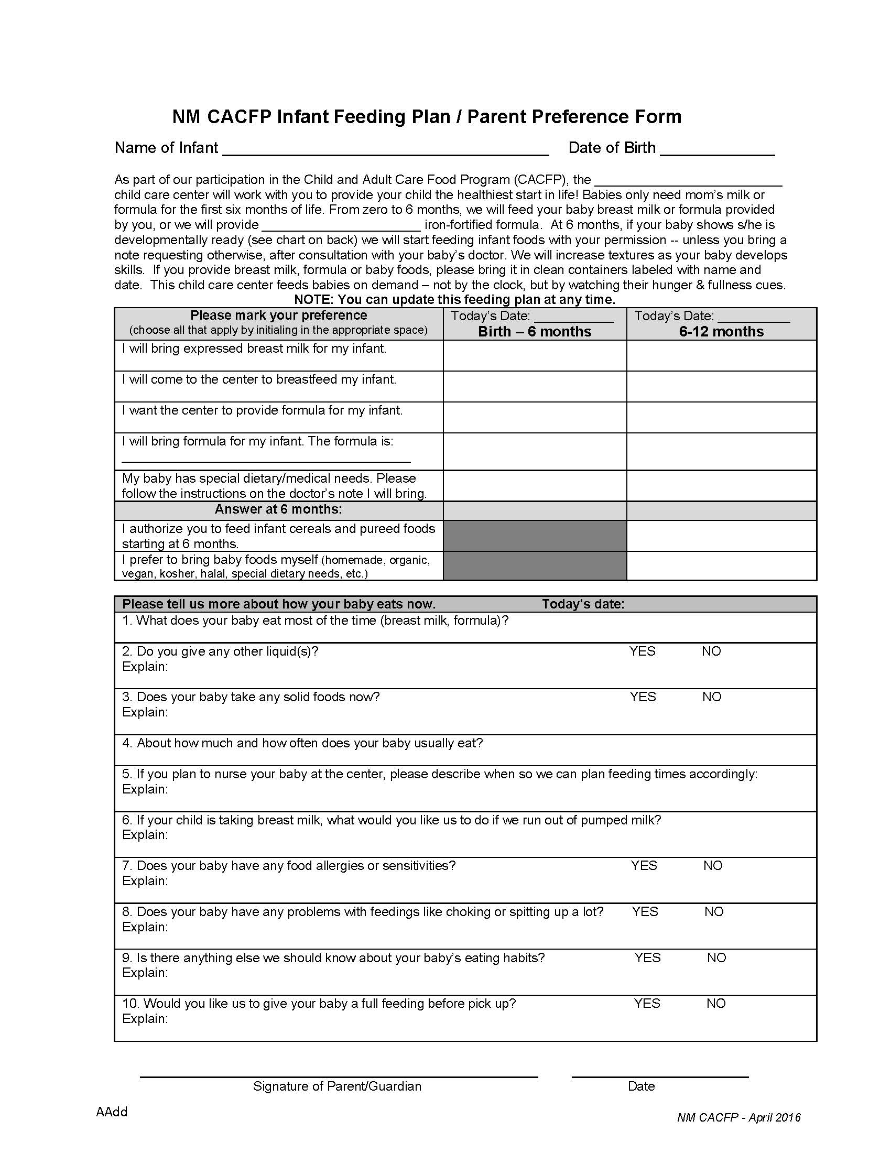
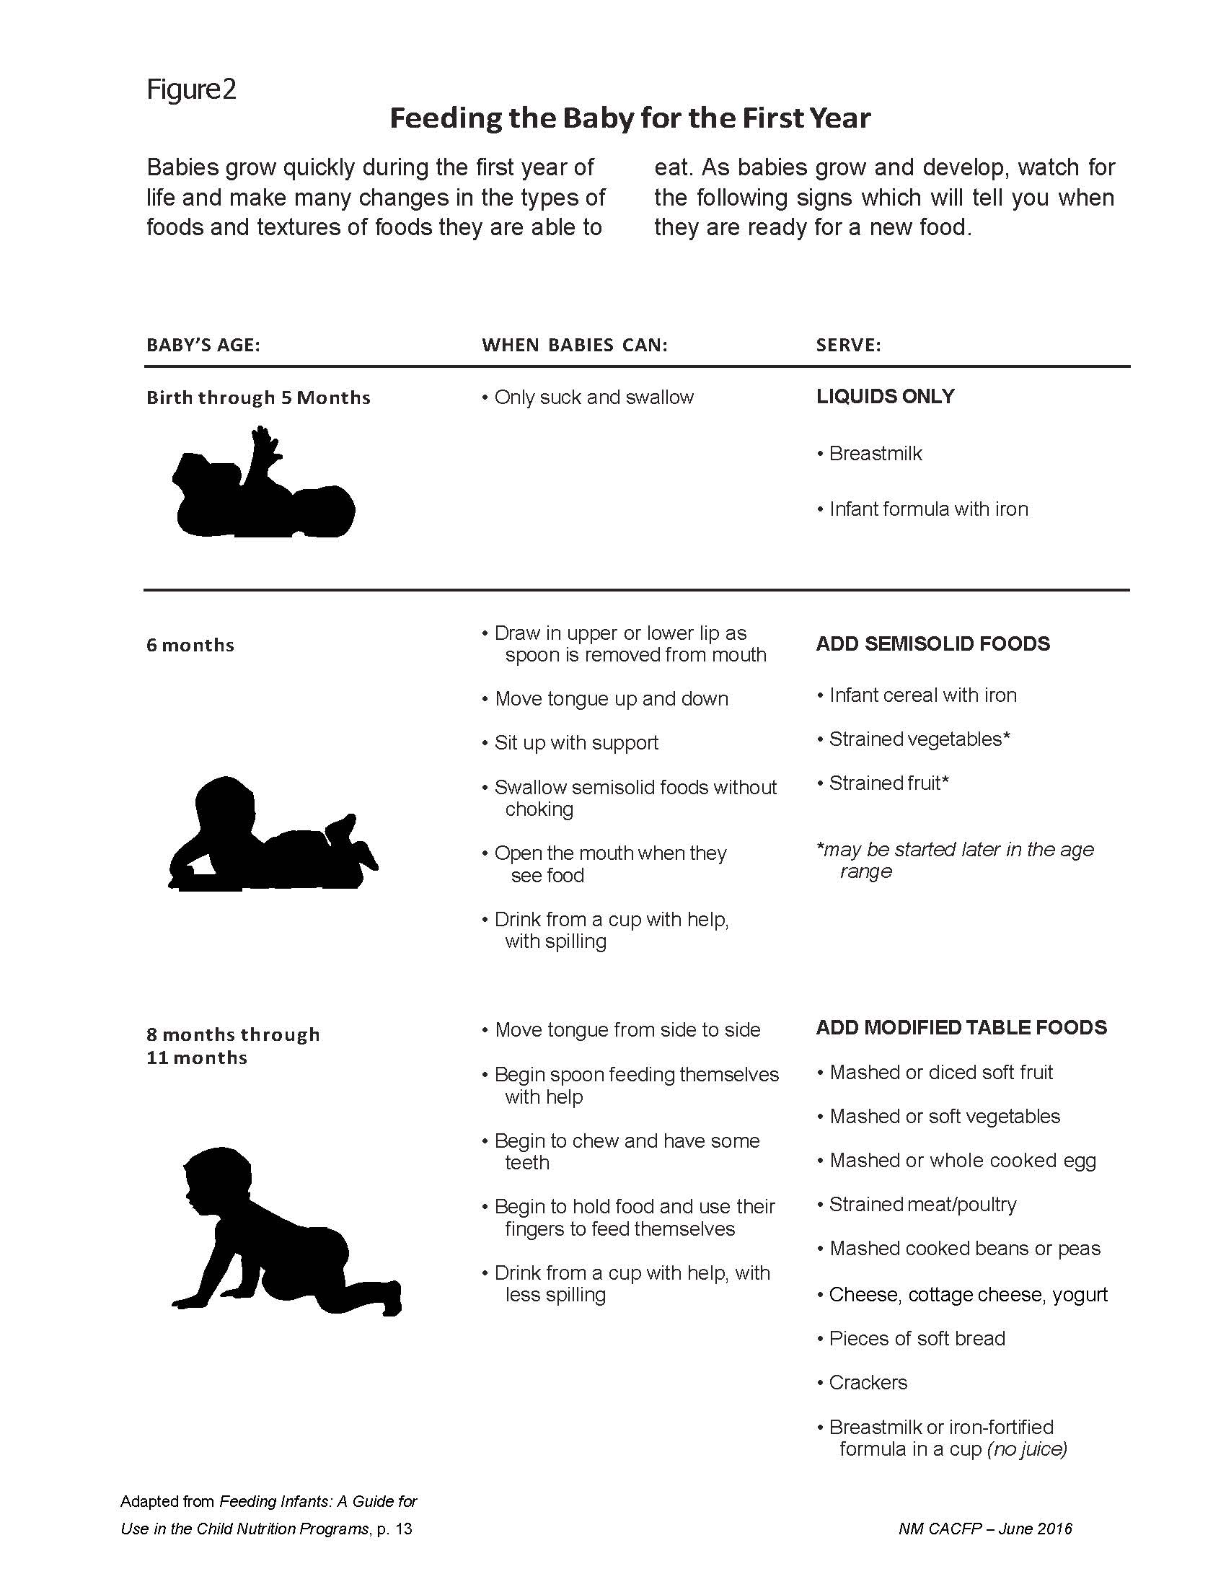
Handout

Slide 10

6 – 11 Months
Can start with any food (not just infant cereal or IFIC) in an appropriate texture
Do not have to serve all components at the same time
  May space them out according to infant’s appetite
  IFIF / breastmilk must ALWAYS be served (give first)
Parents may only provide ONE component – breastmilk is the most important one ☺
By 7 or 8 months, most infants should be consuming solid foods from all food groups
  If not, engage in conversations with parents & infant teachers
  Pediatrician can be a back up
Notes:
The AAP recommends that by 7 or 8 months of age, infants should be consuming solid foods from all food groups (vegetables, fruits, grains, protein foods, and dairy foods except milk). If you have an infant that has not been introduced to all food components by this age, you may need to have a conversation with the parents to see if they have any concerns about their infant eating solid foods, or what their feeding plan is. Infant teachers may also need to be trained on what is appropriate for feeding infants so they can communicate with parents about traditional feeding habits of infants.

Slide 11
Foods to Offer: Purees to Solids
Pureed Foods
Store-bought
Homemade
Semi-Solid Foods
Softened
Table Foods
Appropriate textures and sizes
Finger foods
Mashed
As Infant Becomes Developmentally Ready
Notes:
Foods served to infants will vary depending on the developmental readiness of the infant. Some infants will start with pureed foods that are store-bought or made at your facility by blending whole foods.
The next stage is to served softened or mashed foods.
As the infant gets closer to age one, they may be served table foods in the appropriate textures and sizes.
However, some infants may start out eating table foods, depending on what the parent’s feeding plan is for their infant.
Every infant is different.

Slide 12

Homemade Baby Foods
BENEFITS:
Fresh, healthy, colorful, flavorful, natural
Saves money
Easy!
Helps baby adjust to typical foods
  Less pickiness
HOW:
Cook if needed to puree
No seasoning
Fork-mash, blender, grinder
  Add breastmilk / IFIF / water to thin
  Add IFIC to thicken
Make in advance, or daily
Refrigerate or freeze to store
  Freezer trays = c. 2 oz cubes, perfect for one feeding!
Parent may bring homemade baby food – meal is creditable if parent provides only ONE component!
Notes:
Foods served to infants will vary depending on the developmental readiness of the infant. Some infants will start with pureed foods that are store-bought or made at your facility by blending whole foods.
The next stage is to served softened or mashed foods. As the infant gets closer to age one, they may be served table foods in the appropriate textures and sizes.
However, some infants may start out eating table foods, depending on what the parent’s feeding plan is for their infant.
Every infant is different.

Slide 13

Tips for Introducing Solids
One new food per week, by spoon
  Never put food (even IFIC) in the bottle!
    IFIC in bottle is not creditable
Watch for signs of intolerance / allergy
Try, try again ☺
Document as being offered even if not eaten
Follow parents’ lead

Slide 14
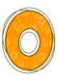

Ounce ranges
Solid food portion sizes start with zero (“0”)
This does not mean the foods are optional – zero is for infants who are not yet developmentally ready.
Offer foods starting 6 mo. or when ready, and document.
  Start with small portion sizes at beginning and increase with age
Notes:
Some infants may be developmentally read to eat solid foods before 6 months of age, some at 6 months of age, and some after 6 months of age. When an infant starts eating solid foods before 6 months, follow the 6-11 month old meal pattern.
We want to remind you to work with parents or guardians to ensure that all newly introduced foods are appropriate for each individual infant and are consistent with their eating habits and developmental readiness. Always consult with parents or guardians about when and what solid foods to introduce to infants.

Slide 15

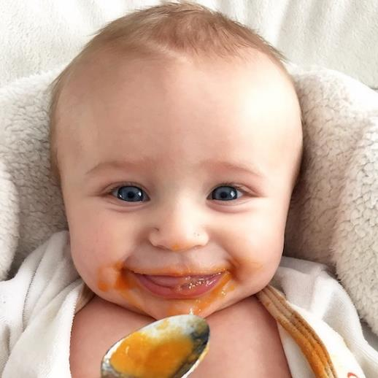
6 – 11 Months Meal Pattern
Breakfast, Lunch & Supper – all the same! ☺
  Iron-Fortified Formula / Breastmilk always required
          and
  Meat/Meat Alternate or Iron-fortified Infant cereal (IFIC) for younger infants, or combination of both may be served → IRON
    Still cannot serve breakfast grain items (pancakes, French toast, waffles, hot cereals) that are served to older children.
    Puffs not creditable
          and
  Fruit, Vegetable or combination of both (no juice)
Notes:
The next few slides will go through changes to foods that can be served to infants, which falls under the 6-11 month old meal pattern.
At breakfast, iron fortified infant cereal, a meat or meat alternate, or a combination of both may be served. This is a change from the previous meal pattern requirement which required iron fortified infant cereal to be served at breakfast to older infants. However, we know that many older infants no longer eat iron fortified infant cereal, so having the option to serve a meat or meat alternate instead provides greater menu flexibility and more options to serve to infants.
With this new allowance, programs still cannot serve traditional breakfast grain items in place of iron fortified infant cereal. Grain items, such as bread/toast, adult cereals, pancakes, waffles, etc. do not provide the same nutrients as iron fortified infant cereal and meat/meat alternates.

Slide 16
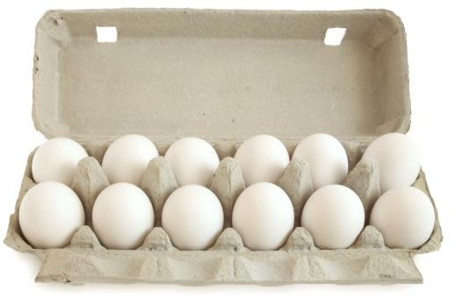
6 – 11 Months Meal Pattern
Meat/Meat Alternates at Breakfast, Lunch & Supper ONLY
  In appropriate texture for developmental abilities:
    Whole eggs
    Yogurt (sugar limits apply)
    Natural cheeses
    Meat, poultry, fish (not shellfish)
    Beans, lentils
  Not Creditable:
    Soy yogurt & tofu
    Processed cheeses, spreads
Notes:
At all meals, breakfast, lunch and supper, infants can be served yogurt and whole eggs. Previously yogurt could not be served and only egg yolks could be served.
Soy yogurt, tofu and cheese food or cheese spread are not creditable to the infant meal pattern.

Slide 17

6 – 11 Months Meal Pattern
Snack – NO Meat/Meat Alternate!!
  Iron-Fortified Formula/Breastmilk always required
            and
  Grain, according to developmental abilities:
    Younger babies (mush/puree):
      Iron-fortified infant cereal or IFIC (oats, barley, rice, wheat)
        Still cannot serve hot cereals for older children (Cream of Wheat, Malt-O-Meal, oatmeal, etc.)
    Older babies (finger foods):
      Bread, tortilla, crackers
      Ready-to-eat breakfast cereals (sugar limits apply)
        Still cannot serve other grain items (noodles, rice, tortilla chips, etc.) that are served to older children.
        Puffs NOT creditable
        Grain-based desserts, honey flavors NOT creditable
            and
  Fruit, Vegetable or combination of both (no juice)
Notes:
For the grains component, in addition to serving bread/crackers that the previous meal pattern allowed, iron fortified infant cereal (for younger infants) and ready to eat breakfast cereals (for older infants) can now be served as an option. Cereals served to infants must meet the sugar limits previously discussed. NO INFANT PUFFS.
At snack, juice can no longer be served to infants. The updated infant meal pattern requires 0-2 tablespoon(s) of vegetables, fruits, or a combination of both be offered during snacks when infants are developmentally ready to accept them. This is an added component at snack. It is based on the American Academy of Pediatrics recommendation to serve infants a variety of foods, including an increased amount of vegetables and fruits. This change promotes vegetable and fruit consumption in infants, and it allows for better acceptance later in life. Vegetables and fruits are great sources of essential nutrients, such as fiber and vitamin C.

Slide 18
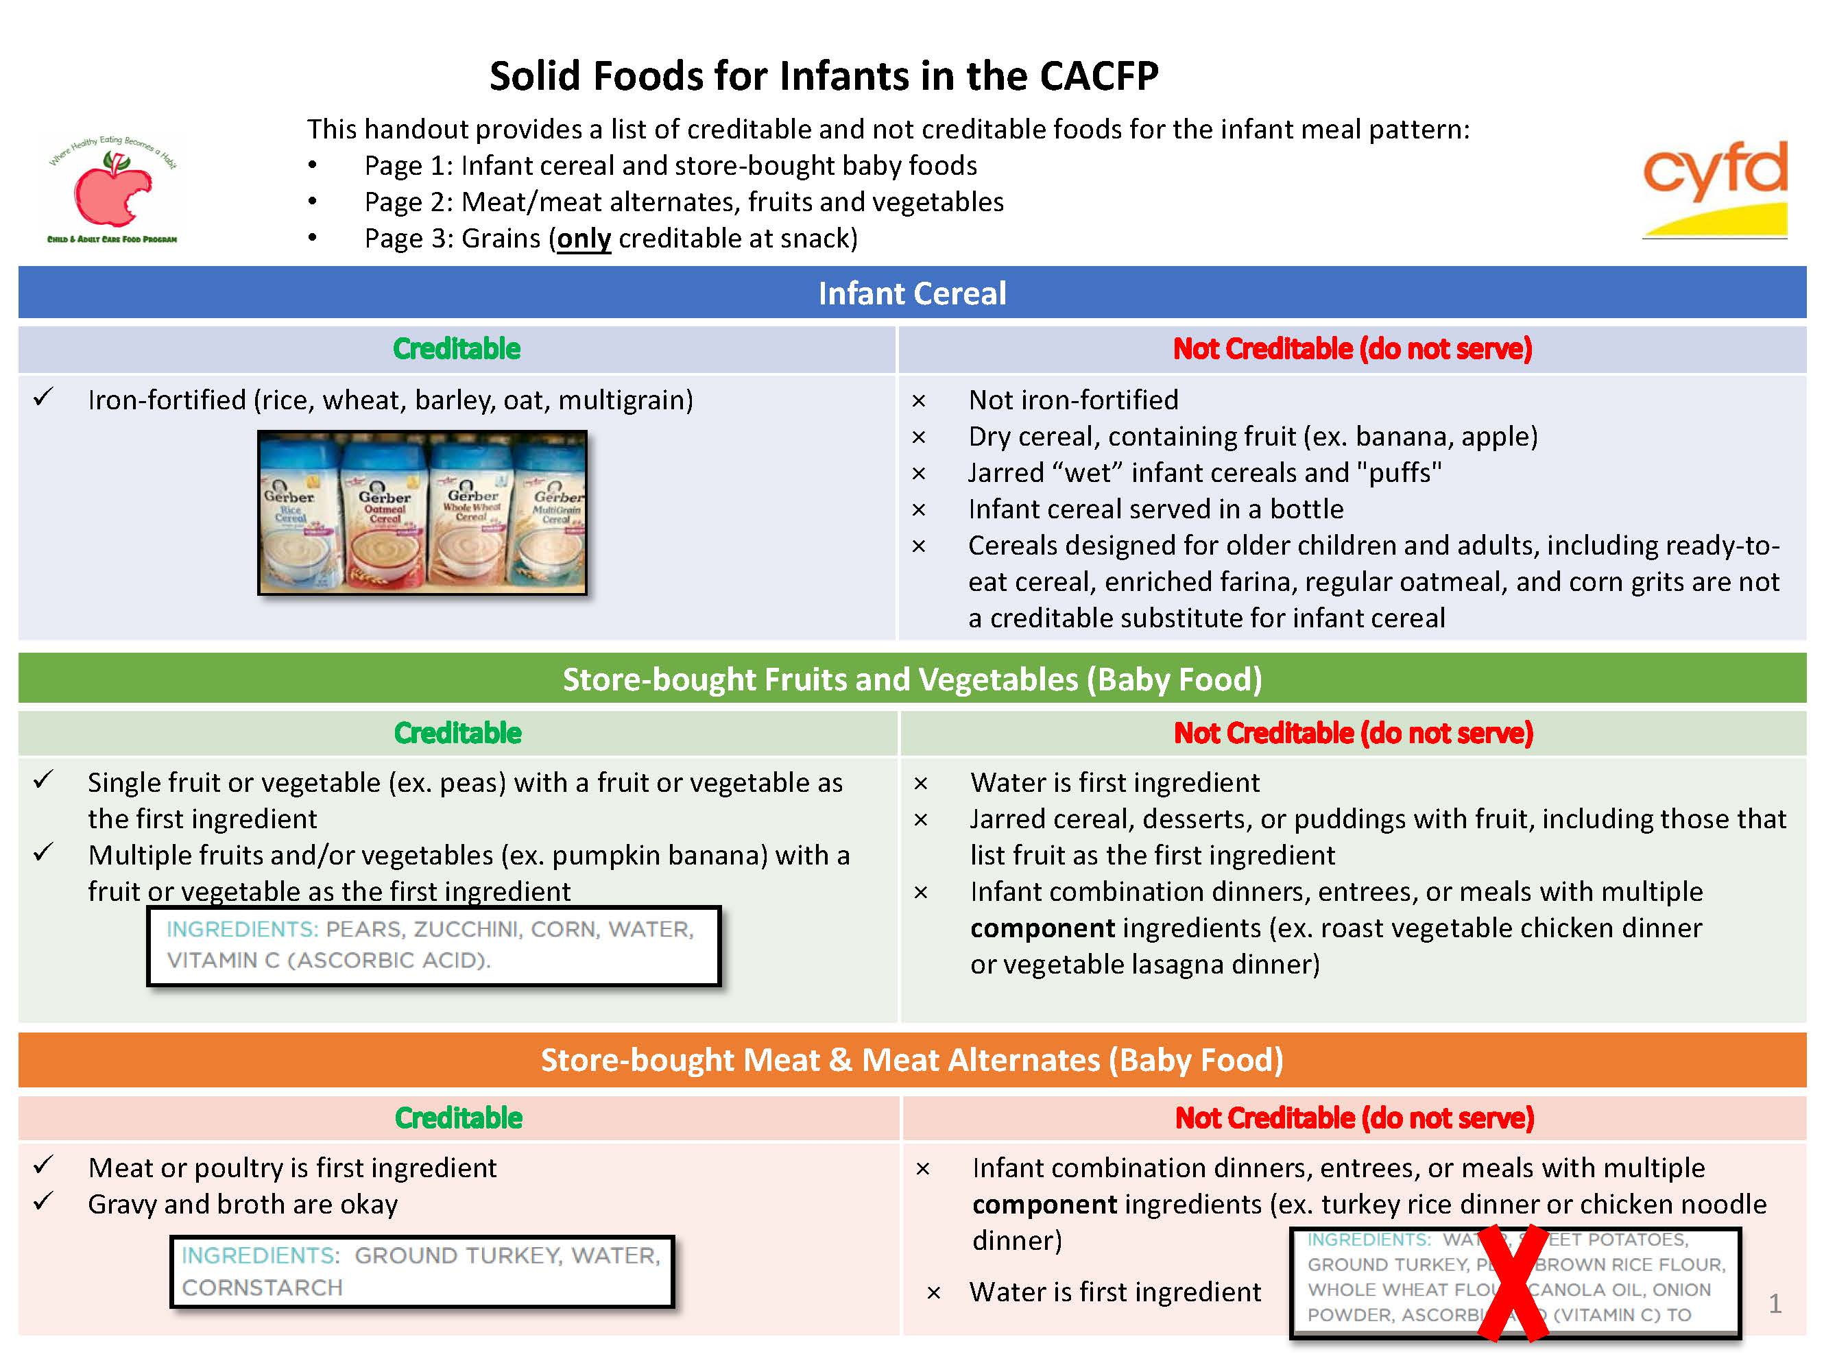
NEW Guidelines Handout:
Solid Foods for Infants in CACFP
Handout

Slide 19
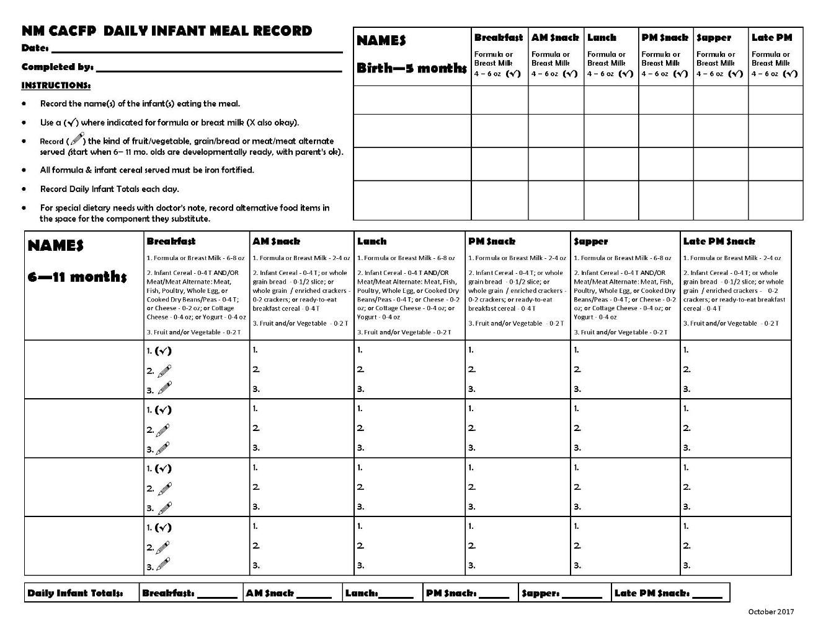
Infant Meal Documentation
Get rid of any older forms!
Document everything offered, not just eaten
Birth – 5 months:
  Breastmilk, IFIF required
  “By mom” / “BFOS”
6 – 11 months:
  Breastmilk, IFIF required
  Introduce foods
Handout
Notes:
There is an updated CACFP Infant Meal Record.
You will see the two age groups. For birth through 5 months, only breastmilk or formula is required to be served.
For six through 11 months, breastmilk or formula is required to be served and foods are gradually introduced until the infant is eating all foods.
When serving expressed milk, there may be times when an infant does not consume the entire serving. For example, some breastfed infants consume less than the minimum serving size of breastmilk for each feeding. In these situations, you may offer infants less than the minimum serving size of breastmilk. However, you must offer the additional breastmilk later, if the infant will consume more, for a reimbursable meal. When serving formula, some infants may not consume the entire serving. However, as long as you offer the minimum serving size, the meal is reimbursable.

Slide 20
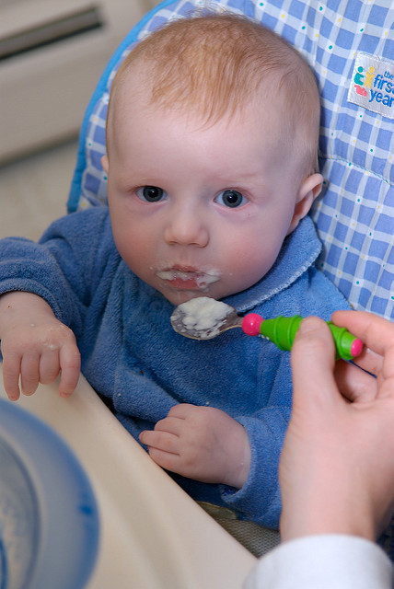
Q&A
Scenario:
  A 5 month old infant is developmentally ready to start eating iron-fortified infant cereal, and parent and center teacher agree to try it.
  How do we document?
  Do we need a doctor’s note?

Slide 21
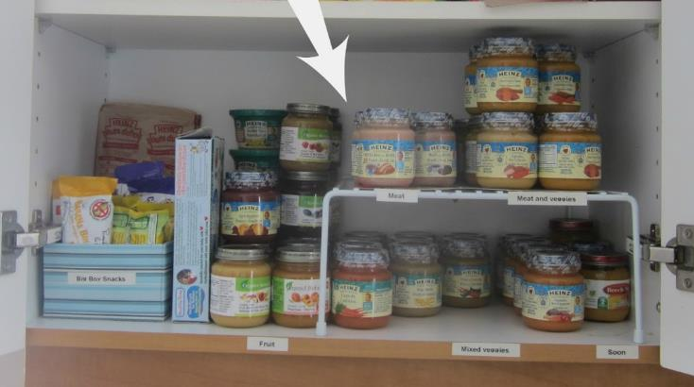
Additional Documentation
Receipts and/or invoices showing formula and foods purchased
  IFIF must be FDA inspected
Formula and baby foods on hand
Notes:
If your program is claiming infant meals and snacks, you will also be purchasing formula and foods for infants. In this case, you must also keep all receipts and/or invoices for these items to verify that they are being purchased and are available.
When a review is completed, the DPI reviewer will want to see that formula and baby foods are available as well.

Slide 22

Transition Period
Breastmilk remains creditable after 12 months
  May serve combination of breastmilk & whole milk
One-month (12-13 mo.) period to transition to whole milk
  May serve combination of IFIF & whole
  Document as whole milk
  IFIF not creditable after 13 months (except with doctor’s note)
Notes:
Also, USDA recognizes that making an immediate switch from whole milk to low-fat or fat-free milk may be challenging for some children. Therefore, the updated meal pattern allows a one month transition period to switch from whole milk to low fat or fat free. During that transition period, you may claim reimbursement for meals served to children 24-25 months of age that include whole milk and mixtures of other milk.

Slide 23
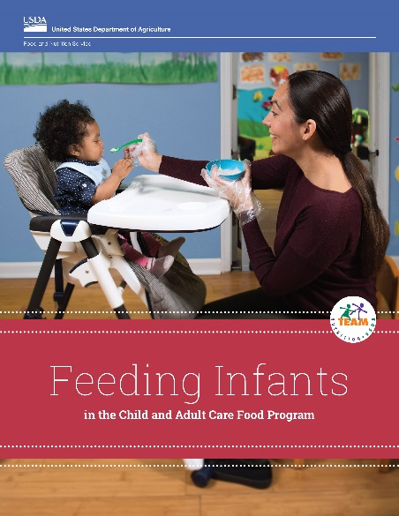
NEW CACFP Feeding Infants Guide – 2019!
More information on:
  CACFP infant meal pattern
  Developmental readiness for solids
  Hunger & fullness signs
  Handling / storing breastmilk & formula
  Parent communication
Download at
  https://www.fns.usda.gov/tn/feeding-infants-child-and-adult-care-food-program

Slide 24

Want to learn more about infants?
View recorded infant webinars at
https://www.fns.usda.gov/cacfp-halftime- thirty-thursdays-training-webinar-series

Slide 25
Infant Meal Pattern
 | Birth to 5 months | 6 to 11 months
Breakfast | 4-6 fl. oz. Formula¹ or Breast milk^{2,3} | 6-8 fl. oz. Formula¹ or Breast milk^{2,3} and 0-4 Tablespoons infant cereal,^{1,4,5} meat, fish, poultry, whole eggs, cooked dry beans or peas; or 0-2 oz. cheese; or 0-4 oz. (volume) cottage cheese; 0-4 oz. yogurt⁶, or a combination⁴ → IRON and 0-2 Tablespoons fruits or vegetables or both⁴
Lunch or Dinner | 4-6 fl. oz. Formula¹ or Breast milk^{2,3} | 6-8 fl. oz. Formula¹ or Breast milk^{2,3} and 0-4 Tablespoons infant cereal,^{1,4,5} meat, fish, poultry, whole eggs, cooked dry beans or peas; or 0-2 oz. cheese; or 0-4 oz. (volume) cottage cheese; 0-4 oz. yogurt⁶, or a combination⁴ → IRON and 0-2 Tablespoons fruits or vegetables or both⁴
Supplement (Snack) | 4-6 fl. oz. . Formula¹ or Breast milk^{2,3} | 2-4 fl. oz. Formula¹ or Breast milk^{2,3} and 0- ½ slice bread^{4,5} tortilla or 0-2 crackers^{4,5} or 0-4 tablespoons infant cereal¹ or ready to eat cereal ^{4,5, 7} and 0-2 Tablespoons fruits or vegetables or both⁴

Slide 26

Questions?

Slide 27
Nutrition Education & Training Staff
Pam Mitchell Manager 841-4853
pam.mitchell@state.nm.us
Teresa Taylor Nutritionist 841-4854
  teresa.taylor@state.nm.us
  Laura Spencer Nutritionist 841-4852
  laura.spencer2@state.nm.us

Slide 28

Thank you!

Slide 29

Staff Breastfeeding
Staff can breastfeed her enrolled infant when the infant is signed in for care
  While working
  During a break
  During off-work hours
Notes:
Your program may also be reimbursed when staff breastfeed onsite when the infant is signed in for care. This is allowed when staff are on work hours, during a work break, and during off-work hours provided the infant is attending that day and signed in for care.

Slide 30
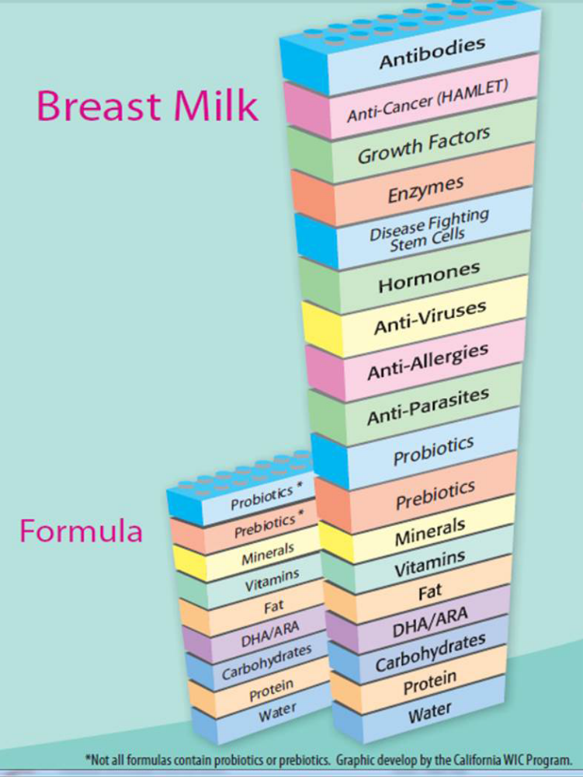
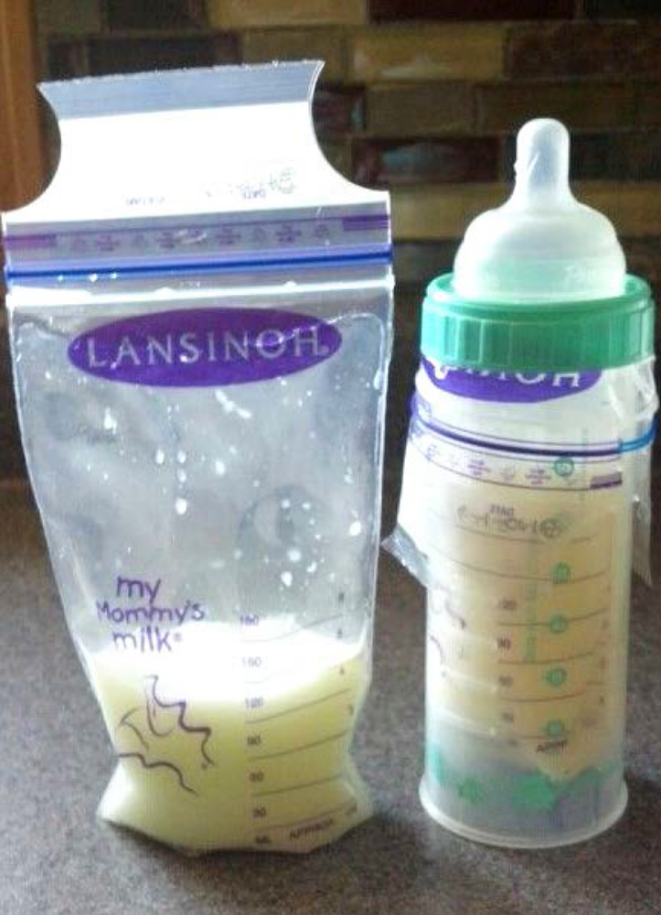

Slide 31
Breastmilk
Storage and Preparation
Storage Locations and Temperatures
Type of Breast Milk | Countertop 77°F or colder (25°C) (room temperature) | Refrigerator 40°F (4°C) | Freezer 0°F or colder (-18°C)
Freshly Expressed or Pumped | Up to 4 hours | Up to 4 days | Within 6 months is best Up to 12 months is acceptable
Thawed, Previously Frozen | 1-2 hours | Up to 1 day (24 hours) | Never refreeze human milk after it has been thawed
Left Over from a Feeding (baby did not finish the bottle) | Use within 2 hours after the baby is finished feeding
Adapted from “ABM Clinical Protocol #8: Human Milk Storage Information for Home Use for Full-Term Infants,” Revised 20

Slide 32

Q&A
Scenario:
  An infant over 6 months is developmentally ready to start eating solid foods, but the infant’s parents don’t want to start yet.
  What can we do?
Notes:
TA given to parents. Respect parent’s decision. As long as the required amount of breastmilk/IFIF is served, the meals are still reimbursable. (Maybe get doctor’s note?)

Slide 33

Q&A
Scenario A:
  Mom is already bringing in breastmilk and now wants to provide homemade baby food too.
  What can we do?
Scenario B:
  Parents want to donate excess WIC formula or food to the center; they are getting too much.
  What can we do?
Notes:
A: Mom can only bring ONE component; either breastmilk or vegetables. Breastmilk is more important to pick, as it can only come from mom and is more beneficial to the infant than formula. The center can puree fresh vegetables on site.
B: Neither WIC nor CACFP allow donations of formula or food. Parents should ask WIC to adjust their food package.
REMINDER: Formulas must be iron fortified, and FDA inspected (made in USA).

Slide 34
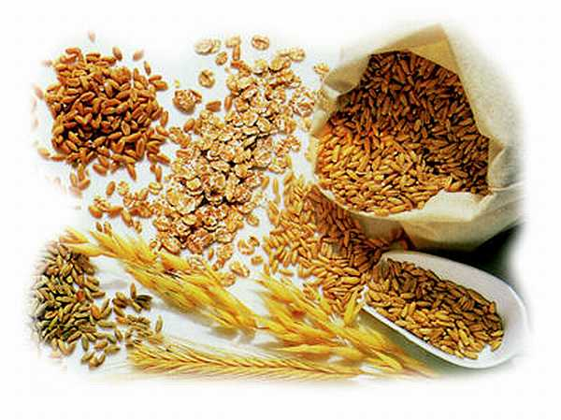
Q&A
Is there a whole grain-rich requirement for infants?
What are some WGR items you could offer infants?
Can we serve hot cereals like Cream of Wheat or Malt-o-Meal instead of IFIC?
Notes:
No, but centers are encouraged to serve WGR foods to infants to promote acceptance of those foods later in life.
IFIC oatmeal and barley cereals. WGR ready-to-eat cereals.
No, only IFIC can be given due to the importance of IRON for infant development.

Slide 35

Q&A
Scenario:
  A baby has taken IFIF or breastmilk, and some IFIC, and is too full for the snack fruit/vegetable component.
  What can we do?
Notes:
Snack now calls for three components once a baby is developmentally ready, instead of two, including a fruit or vegetable (and no juice).
Set meal times are not important for infants. They eat on demand. Staff can offer all components at once, or one or two at a time, with the third component offered later. As long as all the required food components are offered over the course of the entire day, they can be counted towards reimbursable meals.

