Slide 1


Review Results are in !!!
Notes:
Most of the review results are in!

Slide 2

Lets take a look!
Scheduled Reviews
80
Notes:
These are some on the Reviews that we have conducted already this year
We had 80 reviews scheduled for this year

Slide 3

What was being reviewed ?
Permanent Documents
Training records
Claim Verification
Deposit verification
Monitoring reports
Receipts and invoices
Payroll
Notes:
Some of the things that we are reviewing are
Receipts, payroll your monitoring reports the deposits made during the month that we are reviewing the claim the permanent that you save from year to year that we will be reviewing
documents and the training that you will do with your staff for CACFP

Slide 4


Findings
What did we find ???
Notes:
On the reviews we went on these are some of the things that we found !

Slide 5
Initial Reviews 9
Closeouts 4
Regular reviews 67
Notes:
We have 11 program reviews left to conducted for 2019

Slide 6
# of Sponsors / Independent Centers | Summary of Findings | Disallowances
6 | 1 or more Serious Deficiencies | $3,299 - $98,072 $167,697.17
20 | Deficiencies with disallowances | $226 -$2,613 $14,113.194
5 | Deficiencies with minor disallowances | $64 - $192 $604.46
21 | Minor Deficiencies w/ no disallowances | 0
13 | No deficiencies | 0
65 | Total reviews | 11 Remaining to do 11 + 65 =76
Notes:
So this is a recap of what we found

Slide 7
Some examples of how deficiencies can add up to disallowances

Slide 8
Love Kids Child Care submitted a claim for January with a few problems:
This is how their claim looked.

Slide 9


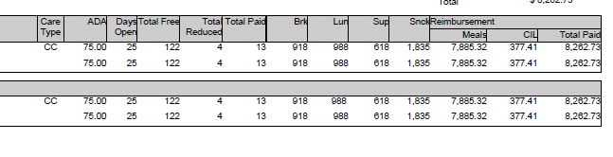
Love Kids Child Care
January Claim for 2019
Notes:
So lets take a look our Made up Center.
Love kids the total claim came to 8,262.73 for the month of January
With 122 total free children reduced was 4 and paid 13

Slide 10

4 Of The Biggest Mistakes
Attendance and meal counts
MRB
IEAs
Receipts
Notes:
These are some of the biggest problems we are finding
Not having the correct meal counts or attendance
Missing info on MRB or even just blank
Having incomplete IEAs or in the wrong category or not having at all
Not having receipts. Or not enough receipts to support the claim or trying to claim things that cannot be claimed or not having the receipts to cover the amount of milk that should have been bought

Slide 11

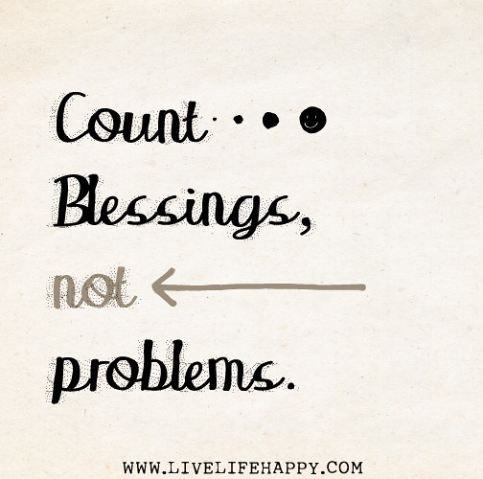
Attendance and meal counts
Notes:
So lets take a look ant the meal counts and attendance for Love Kids

Slide 12
Deficiency
Incorrect meal counts
Over Claim !
Breakfast |  | AM |  | Lunch |  | PM SNACK |  | Supper |  | Late
Claimed | Verified | Claim | Verified | Claim | Verified | Claim | Verified | Claim | Verified | Over | Verified
918 | 858 | NA |  | 988 | 928 | 1724 | 1664 | 618 | 618 | 111 | 111
Notes:
meal counts and attendance that had miscounts.
The numbers of breakfasts, lunches and snacks that were reported on the claim for reimbursement and numbers validated by the reviewers for the test month of January 2019 did not match. This resulted in an over claim

Slide 13
Corrective Action
Reimbursement for a total of $ 342.83 for these meals will be deducted from a future claim .
Please ensure that meal counts are taken & totaled accurately.
Notes:
So minus 60 Breakfasts and 60 lunch's 60 PM snacks which could be maybe a simple wrong click into epics or someone forgetting to write down a couple of days is going to lead to a disallowance of 342.83. Make sure that counts are accurate maybe have a couple of people double check each other

Slide 14
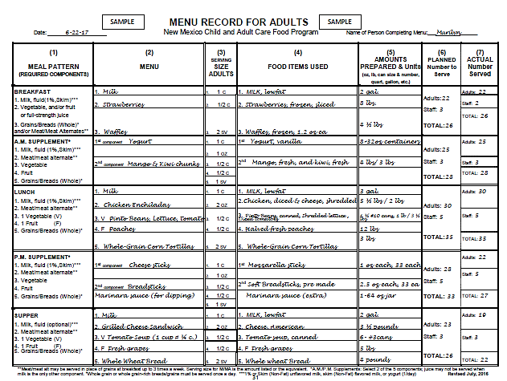
Menu Record Book “MRB”

Slide 15
Deficiency
Menu Record Book reveled meals, which were not eligible for reimbursement
Result
The following meals were not eligible for
Menu Record Book Disallowed Meals “MRB”
Date | Meal | Ineligible Meals Claimed | Comments
1/5/19 | Breakfast | 60 | Missing Grain
1/20/2019 | Lunch | 80 | Missing Vegetable
1/26/2019 | Supper | 90 | Missing Protein
Notes:
Love the Kids had several meals which were not eligible for reimbursement due to noncompliance with the meal pattern, they either served less than the minimum portion size required or did not having proper documentation in the MRB
This is because of !
Some of the reasons might be (missing components) or (serving non-creditable food)
items in place of required components,
shortages of the amount of food prepared, or lack of documentation

Slide 16
Corrective Action
$654.65 is disallowed for ineligible meals.
“The amount disallowed will be deducted from a future claim for reimbursement”
Notes:
The amount disallowed due to deficiencies in the MRB amount disallowed will be deducted from a future claim for reimbursement

Slide 17
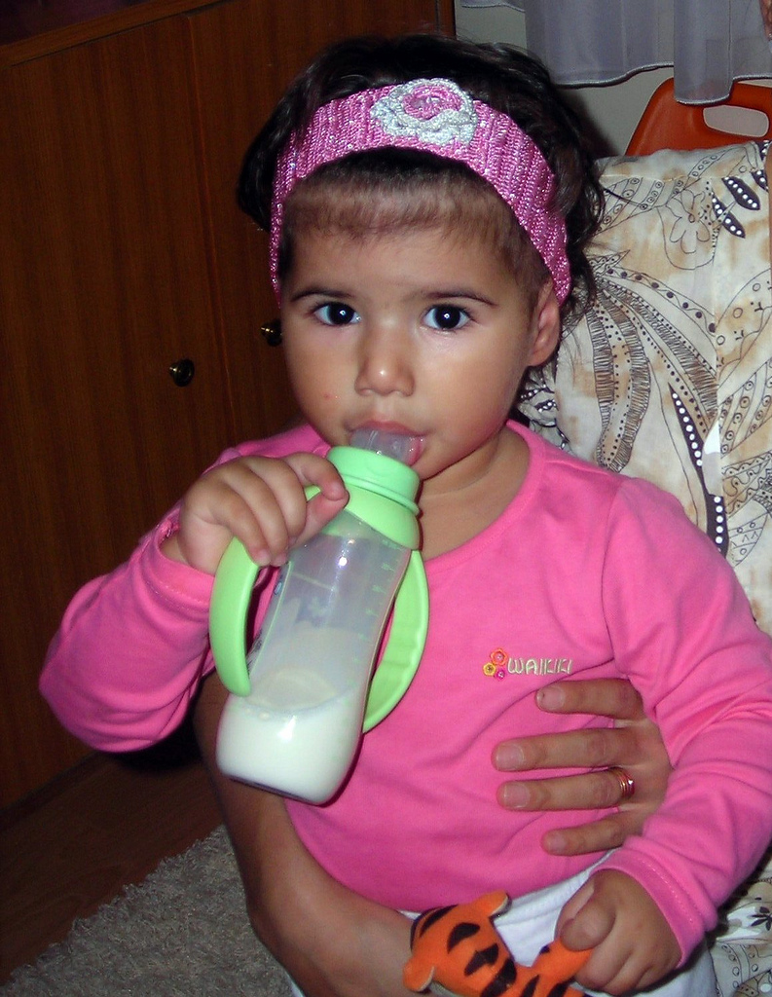


Missing Milk on receipts and invoices ????
Notes:
Love the kids was missing milk receipts

Slide 18
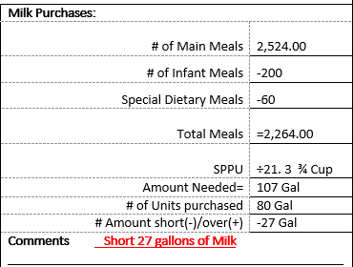
Receipts show not enough Milk bought for the month of January
Deficiency
Missing Milks on receipts
Milk is a required component.
of main meals
Notes:
Love Kids only bought 80 gal they needed 107 so they were short 27 Gal
Receipts show not enough Milk bought for the month of January
918 Breakfast and 988 lunch's suppers 618= 2,524.00 main meals
Upon review of the receipts for sample month it was noted that the amount of milk purchased didn’t support the number of meals claimed that we

Slide 19
Corrective Action
A disallowance of $948.37
“27 Gallons X 21.3 meals per gallon = 575 meals Breakfast Free rate is 1.79 Average here is $1.649
Notes:
This was due to receipts showing an insufficient quantity of milk purchased by the sponsor for the sample month.

Slide 20
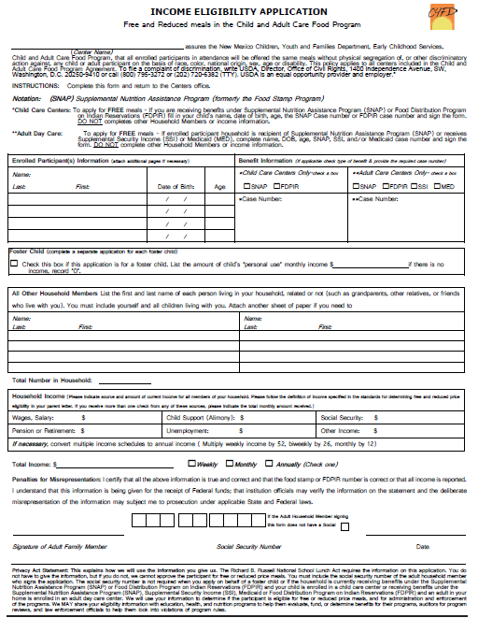
Missing And Incomplete
“IEAS”

Slide 21
Deficiency
Income Eligibility Applications on file did not support the claim IEA’s
Claim Totals and Verified Totals for IEA’s
 | Free |  | Reduced |  | Paid |  | Enrollment
 | Claim | Verified | Claim | Verified | Claim | Verified | Claim | Verified
 | 122 | 90 | 4 | 6 | 13 | 43 | 139 | 139
Notes:
On some of the IEA’s they were categorized incorrectly.
“ As a result, reviewers were not able to verify the numbers reported on the claim.”
Free Center had 122 we had 90
Reduced center had 4 we had 6
Paid center had 13 we had 43

Slide 22
Corrective Action
Adjustment from that claim
A disallowance of $1710.66 was made due to missing or incomplete IEAs
Notes:
please make sure that all Income Eligibility Applications are current, complete, correct and categorized properly and kept on file by type for a minimum of three years

Slide 23


Notes:
Dose anyone have any questions

Slide 24

Perfect
Reviews!!!
Let’s recognize some organizations that had:

