Slide 1

On the Road to Success!
CACFP Recordkeeping

Slide 2


Key points to remember about CACFP
Providing nutritious meals and snacks is the PRIMARY
CACFP is a supplementary program, it is an entitlement program, which requires accurate recordkeeping and program compliance.
CACFP is regulated by Congress and USDA.
Let’s buckle up and let’s start this journey!

Slide 3

Recordkeeping Responsibilities
Maintaining accurate records is vital to making sure CACFP reimbursement accurately reflects the center’s program operations. CACFP forms are available at www.newmexicokids.org

Slide 4
Record Retention
CACFP original records must be maintained on site (for independent facilities), be accessible during licensed business hours and be available for review upon the state reviewers arrival. Sponsoring organizations (two or more facilities) must maintain original records during licensed business hours at the location identified in the Management Plan and be available for review. Program records must be retained for three full fiscal years (October 1 through September 30) after the final claim for the fiscal year was submitted and for longer than three years if review findings have not been closed.
[7 CFR 226.10(d)]

Slide 5


Participant Records
Daily Attendance Records
Enrollment Records
Income Eligibility Applications/Parent Letter

Slide 6



Meal Service Records
Daily Meal Count Records
Daily Menu Record Books
CN Crediting Documentation
Individual Infant Menu Record Book

Slide 7

Financial Management Records
Operating Cost – Allowable expenses for the preparation and service of meals including but not limited to: food costs; food service labor costs; non-food supplies; and costs for purchased services.
Income and Expense Tracking Form-095
Catered or Vended meals documentation

Slide 8

Training Records
CACFP Annual Training Certificate
Documentation of annual training for all staff is required.

Slide 9

Site Monitoring
Documentation of site monitoring for multiple sites.
Nutrition Education
Documentation of monthly nutrition education activities.

Slide 10

Permanent Documents Binder
Current Year Approval Letter, Current Budget & Renewal Application
Form A-2 Management Plan
Renewal Applications for previous 3 years
Form A-3 Site Information Forms
Form-003 Permanent Agreement
Form-010 Non-Pricing Meal Policy Statement or Form-011 Pricing Meal Policy Statement

Slide 11
Form-015 Certificate of Authority
Form-035 Civil Rights Questionnaire
Form-036 Civil Rights Questionnaires from subsequent years
Form-050 Food Service Vending Contract
Form-040 Disclosure & Certification Regarding Lobbying (if receiving $100k+ in Federal $$)
IRS Tax Exempt Letter (501 (c) 3 Notification or Form-055 Title XX Certification for profit centers
State of NM Tax and Rev CRS Registration Certificate
Form-045 NM W-9 Form

Slide 12
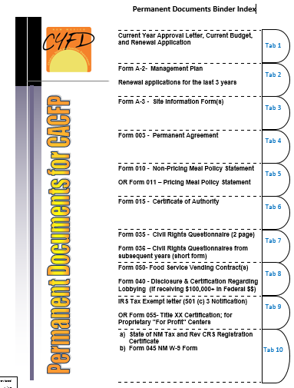
www.newmexicokids.org

Slide 13
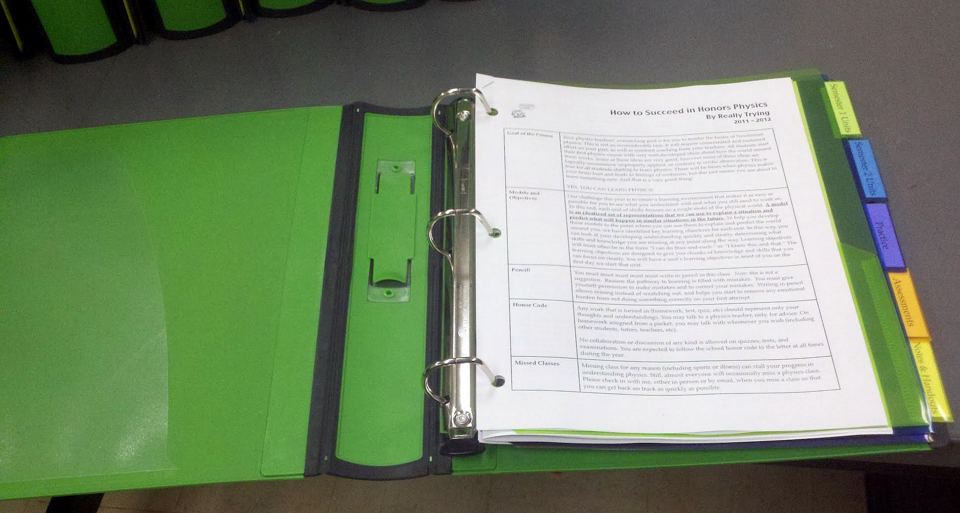
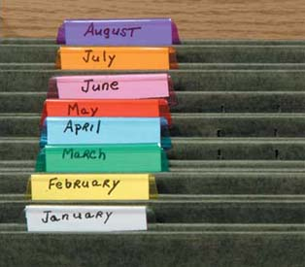

Time to get organized

Slide 14
2019 Record Keeping Errors
Menu Record Books
Income Eligibility Applications
$54,966.81

Slide 15
Let’s talk about
Income Eligibility Applications
Meal reimbursement to child care centers is based on the claiming category of each child enrolled at the center. The claiming category is determined by obtaining family (household) size and household member’s income. This information is compared to the current income eligibility guidelines and the status of the child(ren) in care are determined to be in the free, reduced or paid meal category.

Slide 16
Income information that is obtained from the parent or guardian of enrolled children is critical to your center’s participation in CACFP. Every year, parents or guardians must be given the current Parent Letter and Income Eligibility Application to complete; however completion of IEA is not required. It is recommended that these two items be included in the center’s enrollment packet(s). Form-025 can be printed from the www.newmexicokids.org website.
Income information obtained from the IEA must be kept confidential!

Slide 17
Common IEA Mistakes
IEA is submitted to the center with missing information.
Children are classified incorrectly.
Total household income added incorrectly.
Total number in household incorrect.
Last 4 digits of Social Security number not provided when IEA is based on household income (not required if case numbers are included for SNAP/FDPIR)
Claim category box not checked (determined).
IEA is outdated (valid until last day of the month in which the form was originally dated).
Parent signature and/or date is missing.
Form not signed and/or dated by center representative.

Slide 18
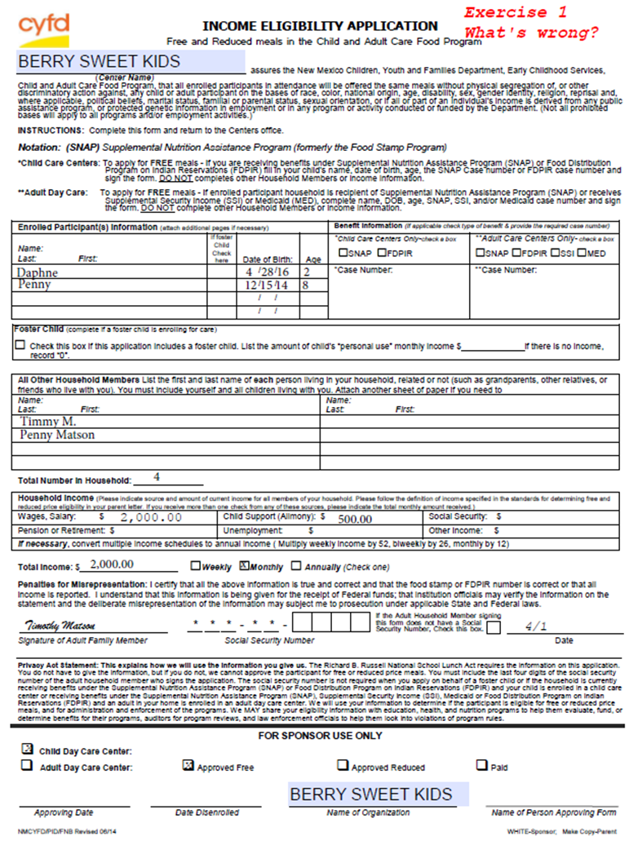
What’s wrong with this IEA?
Practice Exercise is on back page of slides.

Slide 19
Let’s see what’s wrong…
No last names of children. Use children’s legal names only.
Signature is not the name listed as a household member. The use of any kind of nicknames is not allowed and can cause a lot of confusion for reviewers and other staff.
Child Penny is listed in 2 places.
Total in household should be 3 not 4.
The last 4 digits of social security number not listed. Adult signing IEA must list last 4 digits of SSN or indicate that they don’t have SSN when income is used as the basis for eligibility.

Slide 20
Date is not a complete date – the year is not indicated. This could cause the IEA to be determined invalid. Date all forms with complete day, month and year.
Monthly Income is added incorrectly – should be $2500.00.
Category should be reduced, not free. Family of 3 can only make up to $2250.00 per month and still be claimed free.
Center staff did not sign or date IEA.

Slide 21


Yes! your program will be successful!
$
Organizing Records
Learn to climb the Payment Pyramid
Training, Monitoring, Nutrition Education & Permanent Binder
Financial Records
Meal Service Records
Participant Records

Slide 22

USDA Nondiscrimination Statement
SNAP and FDPIR State or local agencies, and their subrecipients, must post the following Nondiscrimination Statement:
In accordance with Federal civil rights law and U.S. Department of Agriculture (USDA) civil rights regulations and policies, the USDA, its Agencies, offices, and employees, and institutions participating in or administering USDA programs are prohibited from discriminating based on race,
color, national origin, sex, religious creed, disability, age, political beliefs, or reprisal or retaliation for prior civil rights activity in any program or activity conducted or funded by USDA.
Persons with disabilities who require alternative means of communication for program information (e.g. Braille, large print, audiotape, American Sign Language, etc.), should contact the Agency (State or local) where they applied for benefits. Individuals who are deaf, hard of hearing or have speech disabilities may contact USDA through the Federal Relay Service at (800) 877-8339. Additionally, program information may be made available in languages other than English.
To file a program complaint of discrimination, complete the USDA Program Discrimination Complaint Form, (AD-3027) found online at: How to File a Complaint, and at any USDA office, or write a letter addressed to USDA and provide in the letter all of the information requested in the form. To request a copy of the complaint form, call (866) 632-9992. Submit your completed form or letter to USDA by: (1) mail: U.S. Department of Agriculture Office of the Assistant Secretary for Civil Rights 1400 Independence Avenue, SW Washington, D.C. 20250-9410; (2) fax: (202) 690-7442; or (3) email: program.intake@usda.gov.
This institution is an equal opportunity provider.

Slide 23

IEA Information Sheets
Attached is additional reference sheets for completing Income Eligibility Applications.

