Slide 1
Funding & Budgets
Lanelle Haught
&
Jesus Aguilar

Slide 2

BUDGET – defined:
“ a plan to help you manage your money”

Slide 3


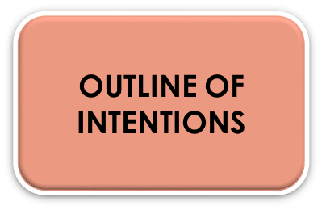
WHAT IS A “BUDGET” ?
Where the money is coming from
Necessary expenses
Total money needed to operate
Anticipated needs and financial resources
Support for Administrative functions
Support for mission “Goals”
Projected earnings and expenses
Detailed line items
Allocation of costs

Slide 4

HOW IS BUDGETING HELPFUL?
OUTLINES INCOME
SUPPORTS MISSION-RELATED GOALS
ALLOCATES RESOURCES
GUIDES SPENDING
FORMALIZES THE PROCESS
USED AS A ROAD MAP

Slide 5

WHY BUDGET?
CACFP COMPLIANCE
UNDERSTAND COSTS
TO STAY FINANCIALLY HEALTHY
SOUND FISCAL PRACTICE
FORECAST FUNDING NEEDS
ALLIGN SPENDING WITH GOALS & MGNT PLAN

Slide 6
“Proposed” Budget Plan
Organizations must account for all program operation costs through the consistent use of generally accepted accounting principals.
Allowable costs are the customary, approved, reasonable & necessary expenses that occur in the normal routine operation of the Child & Adult Care Food Program. - See FNS Instruction 796-2 Rev 4 and 2 CFR 200- Uniform Grant Guidance

Slide 7

CACFP “Proposed” budget
Annually each sponsor receives an approved budget with their approved renewal application.
Must operate as Nonprofit, principally for the benefit of the enrolled participants
Based on total enrollment in the facility

Slide 8

Budget Information
The budget is a guide to help you be successful with your expenses.
Think of it as a spending plan
It helps you to know how you will spend your reimbursement.
It is not a fixed or guaranteed amount and the percentages can be adjusted during the year.

Slide 9
WHAT IS STRATEGIC PLANNING?
MISSION
OBJECTVES
STRATEGY
What do we do?
What priorities will help move closer toward longer-term goals?
TASKS
Where is the business going?
What do we need to do to get there?
How will these activities translate into revenue and expenses?
How is the strategy implemented?

Slide 10
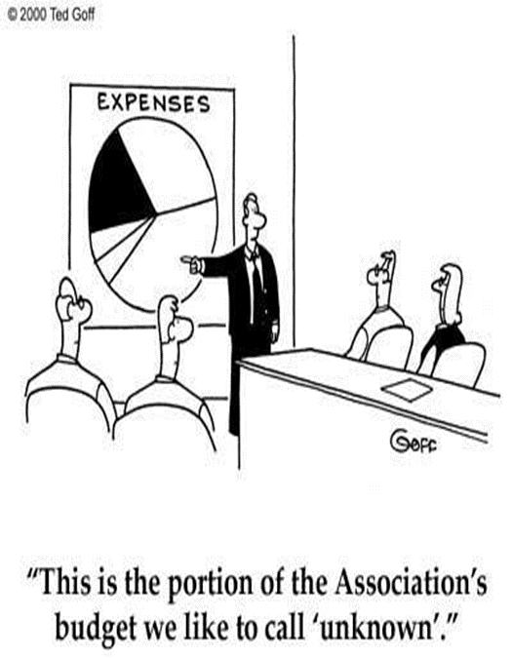
WHAT ARE THE ELEMENTS OF A BUDGET?
Estimated Revenue
CACFP funding
Other income
Estimated Expenses
CACFP costs
Other costs

Slide 11

Projected reimbursement
Take current monthly average expense and multiply by the number of months you will be operation the CACFP.
Ensure that additional or lower costs are included if you plan on adding or deleting sites or making any changes to your meals during that program year.

Slide 12
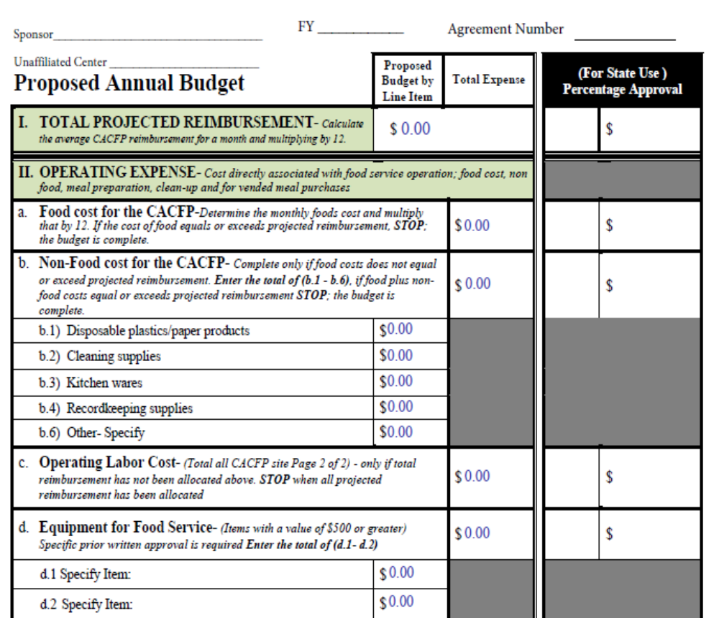
Operating expenses
Food Cost for CACFP
Non-Food cost for CACFP
  Disposable plastics/paper products
  Cleaning supplies
  Kitchen wares
  Recordkeeping supplies
Operation Labor Cost
Equipment for Food Service

Slide 13
“administrative” budgets
Administrative expenses are limited to 15% of the total reimbursement payments received for the year or the net allowable cost of expenses whichever is less
Note: we may approve your budget as requested or it may be modified slightly. Actual approvals are given in percentages.

Slide 14
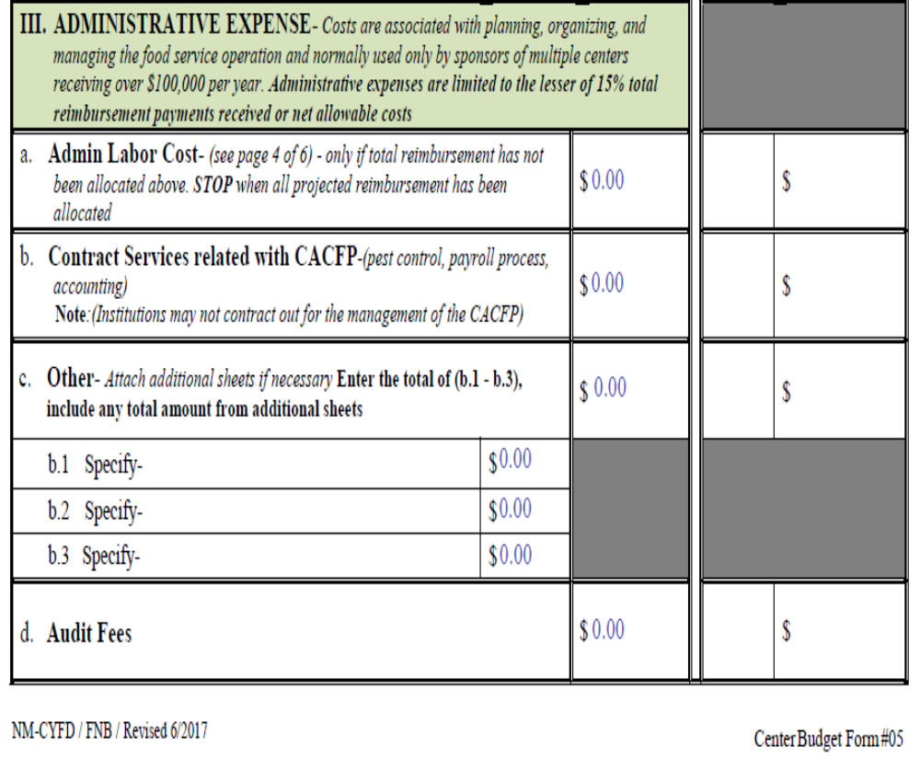
Administrative budget costs
Admin costs are associated with allowable expenses for:
  Planning
  Organizing
  Managing
Examples of these costs:
  Staff labor
  Office supplies
  Site Monitoring
  Other admin expenses

Slide 15
BUDGETING TIPS AND REMINDERS
Consider your fixed and necessary costs first.
Document the rationale for the numbers chosen for the budget.
Use the budget when making spending decisions
Must have Program costs approved prior to incurring the cost.
Must charge non-Program or unapproved costs to non-CACFP funds
Review actual expenses monthly and compare to budgeted plan.
Re-forecast based on actual performance
Update the budget throughout the year.

Slide 16

Thank You & have a great day.

